Slide 1
Session 9 - Resident Equipment & Outbreaks
© 2022 National Association of Directors of Nursing Administration in Long Term Care, Inc. (NADONA LTC).
All rights reserved

Slide 2
Resident Equipment
NADONA

Slide 3
Objectives
Identify 4 areas that considered high touch areas
State 2 recommendations for Disinfection of medical equipment
Determine which items needs to be sterilized

Slide 4
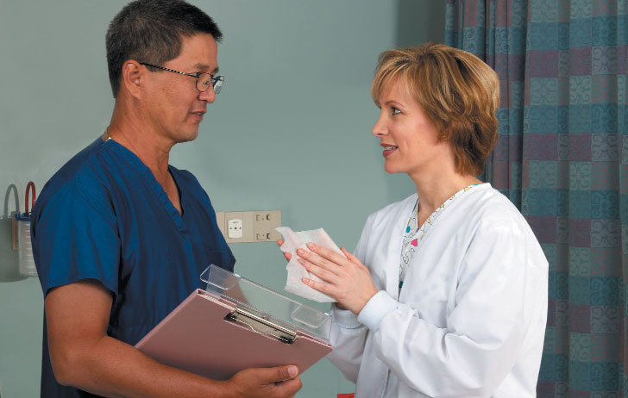
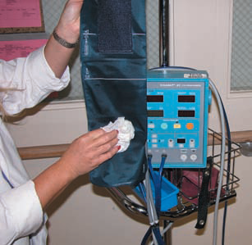
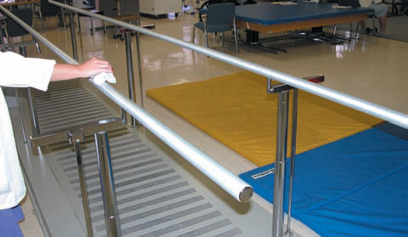
Safe Handling of Patient Care Equipment

Slide 5
Equipment
Patient care equipment that touches intact skin: handle in a manner that prevents skin and mucous membrane exposure, contamination of clothing and transfer of microorganisms to other residents or environments
Ensure that reusable equipment is properly disinfected prior to use on another resident (pulse ox, glucometer, scissors, stethoscopes, tape measures, pens)
Non-Patient care equipment should also be disinfected (Phones, Keyboards)
Beware of GLUCOMETERS!!! – implicated in many outbreaks in LTC and many federal tags in surveys

Slide 6
High Touch Surfaces
Bed Rails Walkers
Light Switches Wheelchairs
Doorknobs Telephones
Blood Pressure Cuffs IV Poles
Stethoscopes Feeding Pumps
PT Equipment Utility Carts
Remote Control Faucet Handles
High-touch surfaces require more frequent cleaning and disinfection than minimal contact surfaces. Cleaning and disinfection is usually done at least daily and more frequently if the risk of environmental contamination is higher (e.g. intensive care units).

Slide 7
Low Touch Surfaces
Floors
Walls
Ceilings
Mirrors
Window sills
Low-touch surfaces require cleaning on a regular (but not necessarily daily) basis, when soiling or spills occur, and when a resident is discharged from the health care setting.
Many low touch surfaces may be cleaned on a periodic basis rather than a daily basis if they are also cleaned when visibly soiled.
NADONA

Slide 8
Key Recommendations for Disinfection and Sterilization of Medical Equipment
Reusable medical equipment must be cleaned and reprocessed (disinfection or sterilization) and maintained according to the manufacturer’s instructions. If the manufacturer does not provide such instructions, the device may not be suitable for multi‐patient use
Assign responsibilities for reprocessing of medical equipment to HCP with appropriate training
Maintain copies of the manufacturer’s instructions for reprocessing of equipment in use at the facility; post instructions at locations where reprocessing is performed

Slide 9
Key Recommendations for Disinfection and Sterilization of Medical
Observe procedures to document competencies of HCP responsible for equipment reprocessing upon assignment of those duties, on hire, whenever new equipment is introduced, and on an ongoing periodic basis (e.g., at least annually)
Assure HCP have access to and wear appropriate PPE when handling and reprocessing contaminated patient equipment

Slide 10
Outbreaks

Slide 11
Objectives
Explain the importance of recognizing an outbreak rapidly
List issues that would prompt an investigation
Identify the steps of an investigation
Discuss how to determine if an outbreak has been resolved

Slide 12
Outbreaks
Definition: The occurrence of more cases of a communicable disease than expected in a given area or among a specific group of people over a particular period of time.
Core Activity of IP: Implementing a system for investigating and reporting incidents of communicable disease to identify, prevent, and control infection outbreaks
Notes:
Sometimes an outbreak is referred to as a “cluster.” Functionally, there is no difference between an outbreak and a cluster, since both need to be investigated and controlled. For uncommon pathogens or serious infections, the occurrence of a single case may be more than what is expected and therefore warrant an investigation.

Slide 13
Outbreaks
An outbreak of a communicable disease is suspected when an epidemiologically linked group of patients, staff or visitors:
develop symptoms associated with or thought to be associated with a communicable disease (e.g. pyrexia of unknown origin, rash, respiratory symptoms, and diarrhea or vomiting)
or when an indistinguishable organism, associated with a communicable disease, is detected from them (e.g. Group A beta-hemolytic streptococcus, MRSA or influenza A).

Slide 14
Outbreaks-cont.
A potential outbreak occurs when susceptible individuals are exposed, or are at risk of being exposed, to a potentially communicable disease.
Outbreak control covers both the prevention of potential outbreaks and detection and management of actual outbreaks.

Slide 15
Outbreaks cont.
A minor outbreak/incident is when the Infection Prevention and Control (IPC) team can deal with the incident using their existing resources, drawing on individuals within the Facility and community and laboratory services as routinely available,
A major outbreak is where action requires resources greater than are routinely available to the IPC team, where action is likely to seriously disrupt the running of the facility or where the outbreak has serious consequences outside the facility
Notes:
Types of outbreaks we may encounter: Clostridium difficile, Human metapneumovirus, Influenza A and B, Measles, Meningococcal infections, Parainfluenza, Pertussis, whooping cough), Respiratory syncytial virus, Varicella (chickenpox), Viral gastroenteritis (including norovirus

Slide 16
Outbreaks cont.
Cluster Outbreak:
Clusters of disease occur frequently and they cause significant concern to the public.
A cluster of health events is defined as an unusual aggregation, real or perceived, of health events that occurs within a group of people, in a geographic area, or over a period of time without regard to whether the number of cases is greater than expected.
Most often, they are reported by employees or individuals expressing concern about apparently similar disease manifestations.
The widespread sentiment is that environmental and/or occupational causes are responsible and must be investigated

Slide 17
Outbreaks-cont.
Pseudo-Outbreak – a situation in which a microorganism is found in culture at a greater rate than expected and that cannot be correlated, from a clinical perspective, with the supposed infection implied by results of cultures.
Could be result of a related cluster of false infections in which the residents were never exposed to, infected or colonized with a pseudo outbreak organism

Slide 18
Review of 2 Outbreaks
Outbreak | Dates | # of staff | # of residents | Symptoms | # hospitalized | Deaths
#1 ( East Coast) | 1/5/12 | 28 | 24 | respiratory | 4 | 4
#2 (West Coast) | 2/8/12 | 29 | 11 | Respiratory/cough | 5 | 2
Cause of infection: : Human metapneumovirus (hMPV)
What is hMPV?
First identified in 2001
Is a virus that has caused outbreaks of respiratory illness among nursing home residents and staff
The incubation period for hMPV is 5–6 days
Transmission likely occurs as a result of direct or indirect contact with infected secretions spread by fomites or through large particle aerosols, similar to other respiratory viruses
Exhibits peak activity during late winter or early spring in temperate climates

Slide 19
Outbreaks cont.
What did they do?
Isolation of residents
Contact and Droplet Precautions ( for those infected)
Increased/Intensive environmental cleaning
Stopped admissions
No congregate dining was held
Activities were held in rooms and 1:1’s
Increased vigilance in identifying and excluding ill staff
Increased importance placed on hand hygiene and respiratory hygiene& cough for all staff, residents and visitors.
Bixler, D., Ibrahim, S., Scott, M., et al. Outbreaks of Human Metapneumovirus in Two Skilled Nursing Facilities - West Virginia and Idaho, 2011-2012. Morbidity and Mortality Weekly Report, 2013; 62(46): 909-913 https://www.cdc.gov/mmwr/preview/mmwrhtml/mm6246a1.htm

Slide 20
Outbreak Steps
Surveillance
Identify the potential issue
Investigate
Analysis
Take Action

Slide 21
Detection and recognition of an outbreak/potential outbreak
The IPC team is responsible for the coordination of the surveillance, subsequent investigation, and control of infection in patients, staff and visitors to the Facility. As such they undertake continuous surveillance for potential outbreaks through various sources:
All potentially serious cases of communicable diseases must be reported to the appropriate member of the IPC team during normal hours and the Clinical Site Practitioner (CSP) and covering microbiologist/infectious disease consultant out of hours.
The IPC team will make an initial assessment of all incidents.
A named person from the IPC team, who will take the infection control lead on any incident – initially the Lead Nurse/Deputy Lead Nurse IPC or Infection Control Doctor.

Slide 22
Early Outbreak Identification
Why is it important?
Essential to implement control measures to prevent:
Resident and staff infections
Lack of staff
Closure of units
Admission constraints

Slide 23
Reasons/ Purpose to Investigate an Outbreak
Identify the source ( get rid of it)
Create strategies to avoid future outbreaks
Review and refine current prevention strategies
Explain new diseases and learn more about recognized diseases
They are also sometimes undertaken to train new personnel or to learn more about the disease and its mechanisms for transmission
Address public concerns
IP role
Notes:
The purpose of an outbreak investigation is to stop transmission of pathogens and prevent additional infections in residents, staff, and visitors. Early recognition of an outbreak and implementation of IPC measures are critical. Documenting the outbreak as it occurs is important. Information, such as findings from case review, results of diagnostic tests, and the interventions employed to stop the outbreak, can capture what is known and support reporting to the necessary parties. Documentation may also provide helpful information for preventing future outbreaks.

Slide 24
What Would Trigger an Investigation
An increase over baseline infection rate
A sudden cluster of infections on a unit or during a short period of time
A single case of an unusual ( rare) healthcare associated infection
Notes:
There are several triggers that should prompt investigation into whether an outbreak is occurring in your facility. In earlier sessions we talked about surveillance and how the data is used to monitor rates of infection in a facility. This data is then used to set a baseline rate that can be used to compare previous rates to the current rate. Baseline rates infection can be calculated by taking the median, or average, rate of infections over a period of time, usually six months or a year. Once you know your baseline you can set a threshold that would trigger an investigation. However even a sudden group ( Cluster) of infections in the same unit, or floor would be enough to start an investigation. Or if they happened in a short period of time may also be suggestive of an outbreak and indicate a need for an investigation. If a single case of a rare infection surfaces that would warrant a immediate investigation. ( EX: Legionella, chicken pox or acute hepatitis A,B,C.)

Slide 25
When should we do an Investigation?
Whether an outbreak investigation will be conducted may also be influenced by
the severity of the disease,
the potential for spread,
unanswered questions
ongoing illness/exposure
the availability of resources, and
sometimes by political considerations or the level of concern among the general public.

Slide 26
Regulations impacting Outbreaks
Nursing Homes must:
Recognize
Contain
Report communicable disease outbreaks
When an outbreak is identified the facility should:
Take appropriate steps to diagnoses and manage cases and prevent further transmission
Documentation steps of investigation
Comply with federal, state and local public health authority requirements
Notes:
. Outbreaks are generally required to be reported to public health authorities, like your local or state health department. In addition, identification of even single cases of certain infectious diseases and pathogens are also reportable. Be sure to check your state’s reportable diseases website to determine the most up-to-date requirements

Slide 27
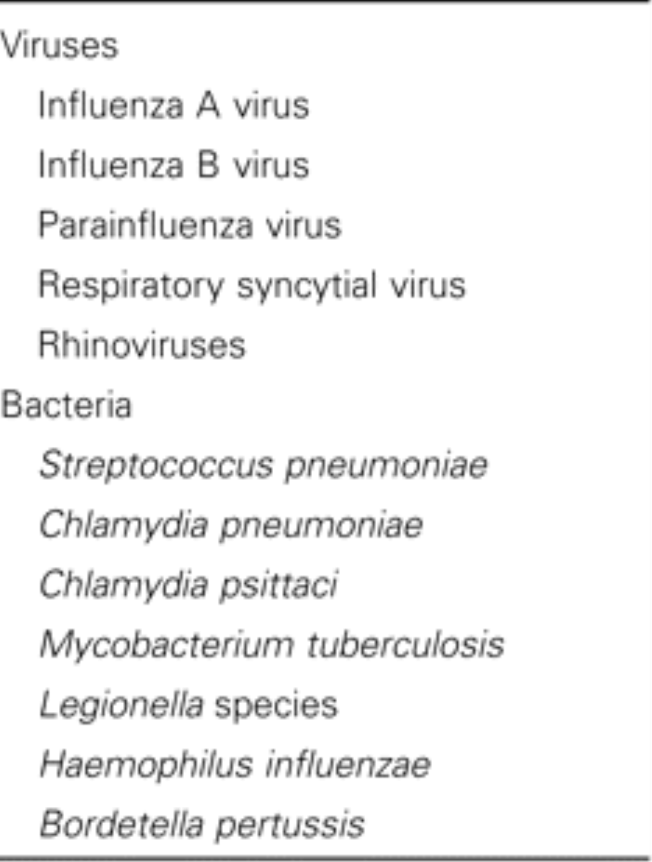
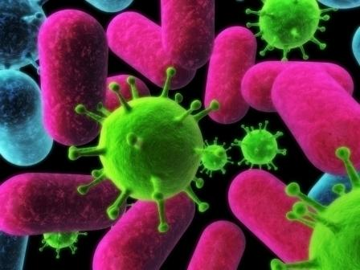
Causes of Outbreaks - Respiratory
Covid-19
From: Infectious Disease Outbreaks in Nursing Homes: An Unappreciated Hazard for Frail Elderly Persons
Clin Infect Dis. 2003;36(7):870-876. doi:10.1086/368197
Clin Infect Dis | © 2003 by the Infectious Diseases Society of America
Notes:
Outbreaks are unfortunately common in nursing homes. Respiratory viruses and gastrointestinal pathogens are the most common causes of outbreaks in nursing homes, but other types of infections can occur.
27

Slide 28
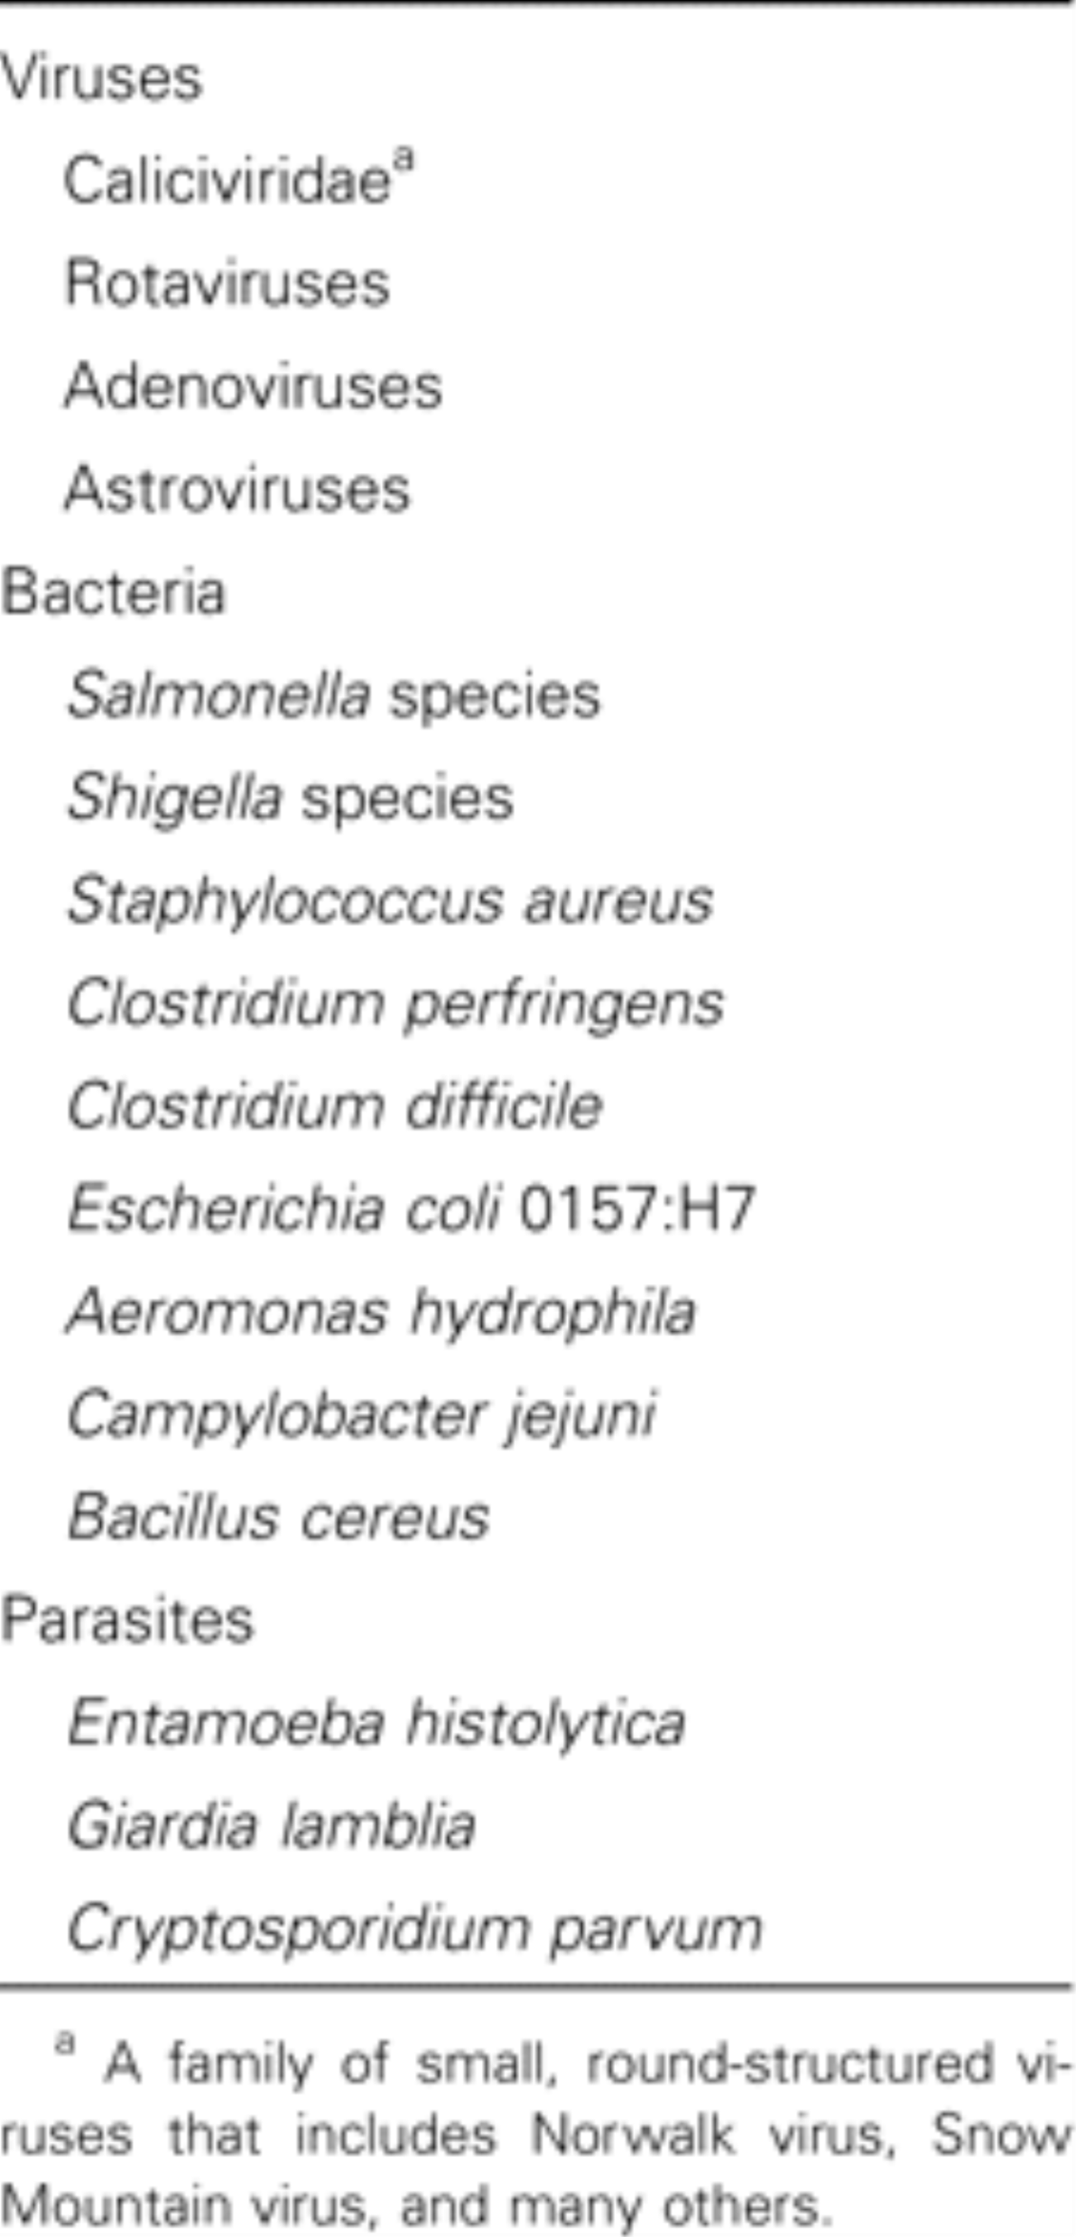
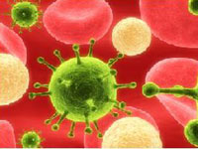
Common Causes of Outbreaks - GI
From: Infectious Disease Outbreaks in Nursing Homes: An Unappreciated Hazard for Frail Elderly Persons
Clin Infect Dis. 2003;36(7):870-876. doi:10.1086/368197
Clin Infect Dis | © 2003 by the Infectious Diseases Society of America
Notes:
Gastrointestinal pathogens may be introduced by contaminated food or infected individual. Other outbreak pathogens include group A Streptococcus and outbreaks syndromes that are relatively common in nursing homes include viral conjunctivitis and skin infections from scabies. Multidrug-resistant organisms like Methicillin-resistant Staphylococcus aureus, or MRSA
28

Slide 29
Principles of Outbreak Investigations
Be systematic!
Follow the same steps for every type of outbreak
Write down case definitions
Ask the same questions of everybody
Stop often to re-assess what you know
Line list and epi curve provide valuable information; many investigations never go past this point
Coordinate with partners (e.g., environmental and epidemiology)

Slide 30
9 steps in an Outbreak Investigation
Step 1 – Confirm that an out break exists
Verify DX and ID the agent
Step 2 – Search for Additional Cases
Step 3 – Characterize the Cases by Person, Place and Time
Step 4 – Form a tentative hypothesis – Best Guess
Notes:
Won’t all be in order …some you will be working on at the same time … start with confirming there is an outbreak and then work through all the steps

Slide 31
(Cont.)
Step 5 – Data Collection and Specimen Management
Step 6 – Test your hypothesis
Step 7 – Refine the Control Measures
Step 8 – Monitor and Evaluate the Control Measures
Step 9 – Prepare and Disseminate a Report

Slide 32
Investigation Steps
1. Before starting on an outbreak investigation, consider necessary preparations:
Make a list of necessary supplies and equipment and make sure you have everything you will need.
Since outbreak investigations frequently involve multiple agencies and jurisdictions, coordinate with them to clarify your role in the investigation and establish contacts.

Slide 33
Investigation Steps cont.
2. Establish existence of an outbreak
What is an Outbreak
Increase in cases above what is expected in that population in that area
Four kids with cough and runny nose in a child care center in January?
Woman vomiting after eating at Restaurant A?
10 members of the swim team vomiting after eating at Restaurant A?
One case of smallpox?

Slide 34
Investigation Steps cont.
Obtain medical records and lab reports
Contact Public Health Epidemiologist in Hospital & Infection Preventionists
Conduct clinical testing if needed
Consult with CDC Branch, State Lab
Notes:
an outbreak is an increase in the frequency of a disease above what is expected in a given population. However, an apparent outbreak can result from either incorrect diagnoses, multiple diseases with similar symptoms, or even changes in record keeping or surveillance practices. It is important to establish that the outbreak is real by examining how the cases were diagnosed and by determining what the baseline rate of disease was previously. For reportable diseases, baseline rates of disease (i.e., the usual or expected rate) can be determined from surveillance data, and you can compare rates during the previous month or weeks with the current rates of disease. For non-reportable diseases or conditions you may be able to find baseline data from state or national vital statistics, from disease registries, or from hospital discharge records. If you have detailed data on the number of cases of disease over time, an epidemic curve is an informative way to display this data graphically, and an epidemic curve can also provide clues about the source of infectious disease outbreaks, as we will see later.

Slide 35
Investigation Steps cont.
3. Construct case definition
Components of Case Definition
Person...... Type of illness (e.g., “a person with...”)
clinical information such as symptoms or lab results, e.g. the presence of fever >101º F and jaundice for hepatitis A or the presence of elevated IgM anti-HAV antibodies in an outbreak of hepatitis A
Personal Characteristics - individuals in a certain age group
Place......... Location of suspected exposure
Time.......... Based on incubation (if known)
a specified time period for this particular outbreak (e.g., during February and March 2009 or among people who attended a specific wedding)
Notes:
By a case definition we mean the standard criteria for categorizing an individual as a case. Establishing a case definition (the criteria that need to be met in order to be considered "a case") can be tricky, particularly in the initial phases of the investigation. You want your definition to specific enough to identify true cases of disease, but you also want it to be broad enough and sensitive enough that it will identify most, if not all of the cases. As a result, the case definition may change during the investigation. In the earliest stages, it might be broader and less specific in order to make sure you identify all of the potential cases ("possible" cases), but later on, it might include more specific clinical or laboratory criteria that enable you to categorize individuals as "probable" or "confirmed" cases.

Slide 36
Investigation Steps cont.
Sample Outbreak Case Definition
Hepatitis A outbreak:
Person: An acute illness involving jaundice or elevated liver function tests
Place: Occurring after visiting or residing on Property A
Time: During May–August 2006
4. Perform descriptive epidemiology/develop hypotheses
Find cases systematically and develop line listing
Clinical information
Symptoms (type, duration)
Onset dates and/or times
Demographic information
Exposure information
Use line list to summarize information
Notes:
As cases are identified it is important to record information in a systematic way and to organize it in a way that will make analysis much easier. Traditionally, the data collected during outbreak investigations was recorded on paper in a "line listing", with each case on a separate row and with the items of information in columns. However, it is much easier to record information in an electronic spreadsheet such as Excel, and this will make it much easier to work with the data, since we will show you how to use Excel to sort the data, create an epidemic curve, and compute tallies that will make the descriptive analysis and the analytical analysis a snap. A spreadsheet makes it easy to create a matrix or table which lists information about each case in a row, with columns for each of the variables of interest (e.g., name, gender, age, address, occupation, laboratory findings, relevant exposures, and columns for each of the symptoms that have been included in the case definition, etc.)

Slide 37
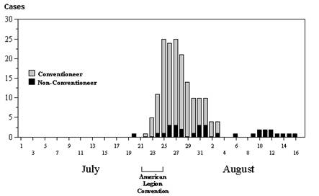
Investigation Steps cont.
Line lists and epi curves useful in developing hypotheses
Epidemic (EPI) Curves
Can suggest type of exposure
Point-source
Person-to-Person
http://sphweb.bumc.bu.edu/otlt/MPH-Modules/PH/Outbreak/Outbreak_print.html
Notes:
Descriptive epidemiology focuses on "person, place, and time", i.e., the personal characteristics of the cases, changes in disease frequency over time, and differences in disease frequency based on location. Characteristics of person, place, and time are the essential elements of for both descriptive epidemiology (to identify possible sources) and for analytic epidemiology (to definitively identify the source).
Changes in the frequency of disease over time are best illustrated with an epidemic curve, which shows the number of new cases at intervals over time. The graph to the right is an epidemic curve for the first outbreak of Legionnaires' disease in 1976 in Philadelphia. An epidemic curve provides a great deal of information. If you know what disease you are dealing with and you know its incubation period, the pattern of disease occurrence over time can narrow down the source of infection.
In essence, an epidemic curve is a bar chart with vertical columns that illustrates number of new cases of a specific disease occurring over a span of time. The key information is the time of onset for each of the cases. To construct the epidemic curve one counts up the number of new cases occurring during fixed time intervals (hours, 1 day, 2 days, 4 days, or some other interval.) The interval that is chosen will depend on the length of the time span of interest and the incubation period of the disease being investigated. A useful rule of thumb is to use an interval that allows you to summarize the outbreak with perhaps 10-20 time intervals, as the epidemic curve for Legionnaires' disease illustrates. It is also useful to show the frequency of disease for a period of time before and after the epidemic as well in order to provide perspective.

Slide 38
Epi Curves
Suggest type of exposure
point-source, person-to-person
Suggest time of exposure
if agent known
Suggest possible agents
if time of exposure known

Slide 39
EPI Curve

Slide 40
Investigation Steps cont.
4. Develop Hypothesis cont.
Differences: If the frequency of disease differs in two locations or circumstances, it may be due to a factor that differs in the two circumstances.
Similarities: If there are similarities among the cases (e.g., many reported eating at a particular restaurant), then that common factor may be the cause.
Correlations: If the frequency of disease varies in relation to some factor, then that factor may be a cause of the disease. For example, communities with low rates of measles immunization may have high rates of measles cases.
Notes:
Once descriptive epidemiology has been conducted and information about person, place, and time is available, it is useful to reflect on the collected information in order to re-evaluate and rank hypotheses about the causes. Hypotheses are generated by consciously or subconsciously looking for differences, similarities, and correlations. Consider the information obtained during hypothesis-generating interviews, and also consider the location of cases (spot map) and the time course of the epidemic in relation to the incubation period of the disease (the epidemic curve).

Slide 41
Investigation Steps cont.
5. Evaluate hypotheses
Additional Studies
Types
Cohort
Case-control
Designed to assess exposures equally among ill and non-ill
Cohort Studies
Include EVERYONE who could have been exposed
Only use if a complete list is available
Meeting attendees, students, LTCF residents, etc.
Measure of association = Relative Risk
Notes:
The next step is to evaluate the hypotheses. In some outbreaks the descriptive epidemiology rapidly points convincingly to a particular source, and further analysis is unnecessary. If analytical studies do not confirm any of the hypotheses generated by descriptive epidemiology, then you need to go back to the descriptive epidemiology and consider other sources and routes of transmission.
In addition, even if analytical studies establish the source, it may be necessary to pursue the investigation in order to refine your understanding of the source. For example, in the Salmonella outbreak described on page 7 it was clear that the manicotti dish was responsible, but what was the specific source? Was the manicotti prepared at home? Was it purchased? What ingredient was responsible for contaminating the manicotti? Was it the eggs used in preparation of the pasta? Was it the cheese?

Slide 42
Investigation Steps cont.
Case-Control Studies
Compare exposures among ill persons (case-patients) and non-ill persons (controls)
Used when a complete list is not available or too large
Restaurant outbreaks, national outbreaks, etc.
Measure of association = Odds Ratio

Slide 43
Investigation Steps cont.
Interpretation of Odds Ratio
OR = 1.0 Same odds of exposure among ill and non-ill
OR > 1.0 HIGHER odds of exposure among ill
OR < 1.0 LOWER odds of exposure among ill
6. Implement control measures
Control Measures
Can occur at any point during outbreak
Isolation, Cohorting, product recall
Balance between preventing further disease and protecting credibility and reputation of institution
Should be guided by epidemiologic results in conjunction with environmental investigation
Notes:
This step is listed toward the end, but, you obviously want to initiate prevention measures as soon as possible if you have identified the source, even if you haven't worked out all of the details

Slide 44
Investigation Steps cont.
7. Communicate findings
Inform IPC Committee
Inform QA&A
Only Do the following if the Public has been made aware of the outbreak!
Inform Public and Media
Public & press are not aware of most outbreak investigations
Media attention desirable if public action needed
Response to media attention important to address public concerns about outbreak
Results of investigations public information
Notes:
When the investigation is concluded, it is important to communicate your findings to the local health authorities and to those responsible for implementing control and prevention measures. The communications usually require both oral and written reports. The written report should follow standard scientific guidelines, and it should include an introduction, background, methods, results, discussion, and recommendations.

Slide 45
Determining Outbreak Resolution
Things to Consider
Incubation periods
Period of Contagiousness
Date of most recent case
Challenges to Determine Outbreak Resolution
Work with Public Health to determine what actions to take when dealing with organisms that can colonize individuals such as antibiotic resistant bacteria
Notes:
When evaluating whether an outbreak has ended, you need to consider three factors. One, the incubation period which is the time from exposure to illness onset. Two, the period of contagiousness which is the time when an infected individual is capable of transmitting disease to others. The duration of illness may serve as an estimate for period of contagiousness. Three, the date of most recent case. You should continue monitoring for new cases for at least one or two incubation periods after the last known case recovers from their illness.
Determining the end of an outbreak can be challenging, especially when dealing with organisms, like antibiotic resistant bacteria or C. difficile, which can colonize a person. Colonization means the pathogen lives in or on a person’s body without causing disease, yet can still be transmitted to others. In those situations, working with local or state public health authorities is particularly important to determine what additional actions (for example, surveillance cultures) may be warranted to declare an outbreak resolved.

Slide 46
Outbreak Evaluation
1. Meet with IDT
2. Determine if any IPC P&Ps need revision
3. Review the following
Cause of the outbreak
What was the root cause of the outbreak?
What was the likely source of the outbreak?
What contributed to ongoing transmission?
How could it have been prevented?
​​​​​​​Evaluate relevant policies and procedures.
Evaluate IPC practices and accessibility of supplies.​​​​​​​
When was outbreak recognized
Was the outbreak recognized in a timely manner?
What contributed to delays?
Notes:
While drafting your final report, you should also be evaluating the outbreak experience and looking for opportunities for improvement. An interdisciplinary team, which may be your Quality Assessment and Assurance committee, but should include front-line staff involved in the outbreak, can discuss how effective the facility’s detection and response were in controlling the outbreak and determine whether any changes to the IPC policies, procedures, or program activities are warranted to improve future outbreak responses. Topics you should consider during your outbreak evaluation include identifying the cause of the outbreak, recognition of the outbreak, implementation of IPC measures, and communication of the outbreak.
Your first outbreak evaluation question might be: What was the root cause of the outbreak and how could it have been prevented? If, as in our scenario, an ill staff member was the likely source of the outbreak or contributed to ongoing transmission, you may want to evaluate your facility’s sick leave policies to see whether any changes are needed that could support employees staying home when ill. If the outbreak resulted from person-to-person spread, such as through droplet transmission, you may want to evaluate your respiratory hygiene and cough etiquette program and the accessibility of facemasks, tissues, and hand hygiene supplies.
Your next outbreak evaluation question might be: Was the outbreak recognized in a timely manner? In our scenario, the first case occurred on February 1, but the facility IP wasn’t notified until February 4, after an additional nine individuals had become ill. This delay may have resulted because these cases occurred over the weekend and the weekend staff were not sure whom to notify. The facility may either need to designate a backup person for the IP or establish criteria for contacting the IP or other facility leadership for urgent IPC-related concerns occurring outside of normal work hours.

Slide 47
Outbreak Evaluation cont.
What IPC measures were implemented
Were appropriate IPC measures implemented in a timely manner?
Are policies supportive of timely implementation?
Who was communicated with regarding outbreak
How effective were your efforts to educate staff, residents, and visitors?
Was the health department notified in a timely manner?
What communication strategies (e.g., in-services, town hall meetings, emails/letters) worked best for notifying and updating staff, residents, and visitors?
Notes:
Another important question to ask as part of your outbreak response evaluation is “Were appropriate IPC measures implemented in a timely manner?”, Contact Precautions includes use of gown and gloves for all interactions that may involve contact with the resident or potentially contaminated areas in the resident’s environment. Implementation of Transmission-Based Precautions should occur promptly based on clinical presentation when a communicable infectious disease is suspected and should not be delayed pending confirmation of the diagnosis. Because early implementation is important to halt ongoing transmission, facilities are encouraged to have policies and procedures to allow nursing staff to implement Transmission-Based Precautions should occur promptly based on clinical presentation when a communicable infectious disease is suspected and should not be delayed pending confirmation of the diagnosis. Because early implementation is important to halt ongoing transmission, facilities are encouraged to have policies and procedures to allow nursing if communicable disease is suspected, even before a physician order has been obtained. In our scenario, it is possible that the facility did not have such a protocol and staff didn’t feel empowered to implement Contact Precautions without a confirmed diagnosis or a physician order. These issues should be a topic of discussion for the interdisciplinary team and might warrant modification to existing policies and procedures and educating staff to remind them of how to respond should a similar scenario occur in the future.
Finally, it’s important to discuss your communication activities during the outbreak. Questions to consider include: How effective were your efforts to educate staff, residents, and visitors? Was the health department notified in a timely manner? And, what communication strategies (for example, in-services, town hall meetings, emails or letters) worked best for notifying and updating staff residents and visitors? You might consider surveying residents and visitors to see how future communications might be improved.

Slide 48
Final Report
Section 1: Facility Information
Health Dept. Contact Name and Phone Number: An LTC facility should have contact information (name or division, phone number) for the local and/or state health department for outbreak guidance and reporting purposes. Enter the health dept. contact information your facility used to request support during an outbreak.
Date First Notified Health Department: Record the date you first contacted local or state public health during this outbreak at your facility.
Total # of Residents at Facility: Document the total number of residents in the facility at the time of the outbreak.
Total # of Employees: Document the total number of staff working in the facility at the time of the outbreak. Staff includes all healthcare personnel (e.g., nurses, providers, consultants, therapists, food services, environmental services) whether employed, contracted, or volunteer
Notes:
You should include information about the current resident census of the facility and the number of staff working at the facility. You should also document your interactions with the health department, including the date they were first notified about the outbreak.

Slide 49
Final Report cont.
Summary Form Status: Information in the summary form may be completed over the course of the outbreak. Record the dates your facility started collecting information on the form and completed the outbreak summary report.
Case Definition
Case Definition: You should record the final case definition that was used during the investigation.
Outbreak Period Information
Outbreak Period Information: This section will capture when the outbreak started and ended; the average length of illness for cases; and the total number of residents and staff who met the case definition

Slide 50
Final Report cont.
Laboratory Test
Laboratory Tests: This section will capture which organisms were identified through laboratory testing. For example, in our norovirus scenario, you would document the norovirus results for affected residents and staff.
Staff Information
Staff Information: This section will capture more detailed information about infected staff, including whether any worked while ill and whether any required outside medical care, such as visits to the emergency department or hospitalization.

Slide 51
Final Report cont.
Resident outcome
Resident Outcome: Information about morbidity and mortality of infected residents is a critical outcome. This section will capture how many residents required hospitalization or died.
Facility Outbreak Control Measures
Facility Outbreak Control Measures: This is where you would document the control measures that were implemented during the outbreak. This section can be an important reference for future outbreaks, as it will remind you which measures were most effective.
Number of new Cases per Day
Number of New Cases per Day: This is information you should have been tracking to generate your epi curve and assess efficacy of control measures
Issues that need to be addressed
.

Slide 52
Worksheet for Outbreak Management
North Dakota Depart. of Health: https://www.ndhealth.gov/disease/hai/Presentation/Outbreak_Investigation_Form.pdf
Notes:
From Gail Bennett

Slide 53
Quiz Question
If a manufacturer does not provide cleaning and disinfecting instructions the equipment should be used on only one resident.
A. True
B. False
Please submit answer with other homework to your instructor.

Slide 54
Resources
sphweb.bumc.bu.edu/otlt/MPH-Modules/PH/Outbreak/Outbreak_print.html
https://academic.oup.com/cid/article/36/7/870/318878
https://www.cdc.gov/mmwr/preview/mmwrhtml/mm6246a1.htm
https://epi.publichealth.nc.gov/cd/lhds/manuals/cd/training/Module_1_1.6_ppt_OutbreakInvestigation.pdf
file:///C:/Users/OEM/Documents/Infection%20Control%20Training/Guidelines%20_%20Containment%20_%20HAI%20_%20CDC.html
file:///C:/Users/OEM/Documents/Infection%20Control%20Training/how-cdc-help-resolves-outbreaks-hc-facilities-508.pdf
https://www.cdc.gov/injectionsafety/pntoolkit/index.html

Slide 55
https://www.cdc.gov/hai/outbreaks/outbreak-resources.html
https://www.health.qld.gov.au/clinical-practice/guidelines-procedures/diseases-infection/infection-prevention/management-advice/trigger/strategies
https://www.ndhealth.gov/disease/hai/Presentation/Outbreak_Investigation_Form.pdf
https://www.sciencedirect.com/topics/medicine-and-dentistry/pseudoinfection#:~:text=The%20term%20pseudo%2Doutbreak%20means,implied%20by%20results%20of%20cultures.

