Slide 1

Session 6 - Hand Hygiene
© 2022 National Association of Directors of Nursing Administration in Long Term Care, Inc. (NADONA LTC).
All rights reserved.

Slide 2
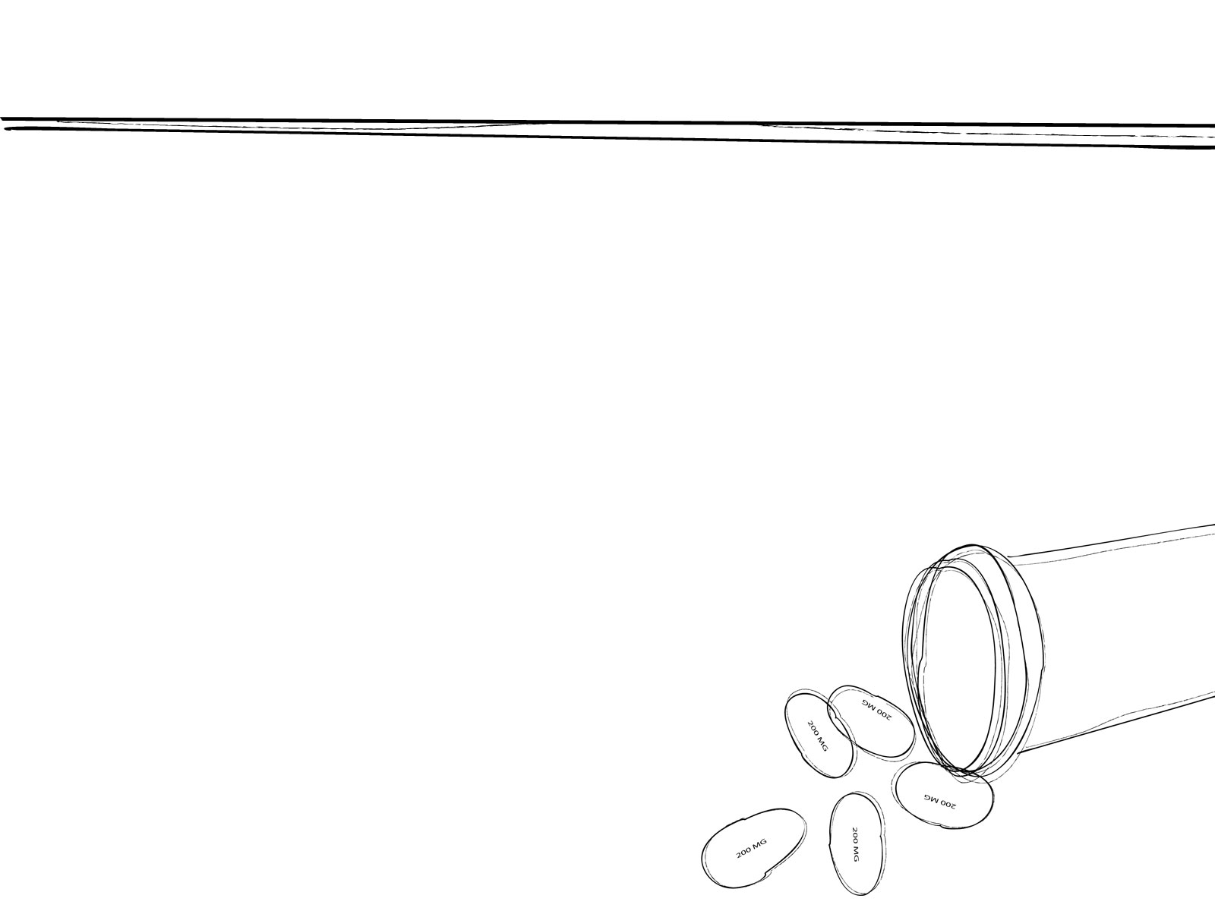

Objectives
Participants will be able to:
Identify appropriate hand hygiene methods, products, and indications.
Outline when soap & water should be used instead of an alcohol-based gel or wipes
List 3 items that need to be addressed in the hand hygiene policy & procedure
Explain the three components of education

Slide 3
Definitions
Definition of Terms
Alcohol-based hand rub. An alcohol-containing preparation designed for application to the hands for reducing the number of viable microorganisms on the hands. In the United States, such preparations usually contain 60%–95% ethanol
or isopropanol.
Antimicrobial soap. Soap (i.e., detergent)containing an antiseptic agent.
Notes:
Hand hygiene is a critical practice to prevent the spread of pathogens, including those that are resistant to antibiotics, and to reduce the risk of infections in healthcare settings

Slide 4
Definitions cont.
Antiseptic agent. Antimicrobial substances that are applied to the skin to reduce the number of microbial flora. Examples include alcohols, chlorhexidine, chlorine, hexachlorophene, iodine, chloroxylenol (PCMX), quaternary ammonium compounds, and triclosan.
Antiseptic handwash. Washing hands with water and soap or other detergents containing an antiseptic agent.
Antiseptic hand rub. Applying an antiseptic hand-rub product to all surfaces of the hands to reduce the number of microorganisms present.
Decontaminate hands. To Reduce bacterial counts on hands by performing antiseptic hand rub or antiseptic handwash.

Slide 5
Definitions cont.
Hand antisepsis. Refers to either antiseptic handwash or antiseptic hand rub.
Hand hygiene. A general term that applies to either
handwashing, antiseptic handwash, antiseptic
hand rub, or surgical hand antisepsis.
Handwashing. Washing hands with plain (i.e., non-antimicrobial) soap and water.

Slide 6
Definitions cont.
Antiseptic handwash or HCW handwash. An antiseptic containing preparation designed for frequent use; it reduces the number of microorganisms on intact skin to an initial baseline level after adequate washing, rinsing, and drying; it is broad-spectrum, fast-acting, and if possible, persistent.

Slide 7
It all started back when…
Ignaz Semmelweis 1815-1865
In the 1840’s at the General Hospital in Vienna discovered high mortality rates due to Childbed Fever (Strep) among obstetrical patients.
Forced doctors under his supervision to wash their hands before touching patients
Notes:
Hand hygiene is the process of cleaning your hands by using handwashing, antiseptic handwash, antiseptic hand rub, or surgical hand antisepsis. In nursing homes, hand hygiene is typically performed by using either alcohol-based hand rub, or ABHR, or washing hands with soap and water. Hand hygiene is an element of Standard Precautions and an important IPC practice for breaking the chain of infection

Slide 8
When Health Care Makes You Sick

Slide 9
Hand Hygiene
Hand hygiene is the process of cleaning your hands by using hand washing, antiseptic hand wash, antiseptic hand rub, or surgical hand antisepsis.
Hand hygiene prevents the spread of pathogens:
  Transferred through direct or indirect contact
  Staff hands become contaminated through caring for residents
  Pathogens are removed through hand hygiene thus protecting both staff and residents
​
Notes:
. Hands of staff members can even move a resident’s own pathogens from a contaminated body site, such as a wound, to a clean site, such as an intravenous, or IV, line

Slide 10
WHY IS HAND HYGIENE IMPORTANT?
Infections are a serious problem in healthcare facilities.
  722,000 estimated HAI’s in the US healthcare system in the acute care population alone
  75,000 deaths from HAI’s in hospitalized patients
Many infections are transmitted on the hands of healthcare personnel.
Hand hygiene can reduce the transmission of healthcare-associated infections – to your patients and to you.

Slide 11
DO YOU USE HAND HYGIENE WHEN YOU SHOULD?
Healthcare personnel practice hand hygiene about 40% of the times they should. Hand hygiene is often not practiced:
    Immediately before touching a patient, performing an invasive procedure, or manipulating an invasive device
    Immediately after touching a patient, contaminated items or surfaces, or removing gloves
    After removing gloves
    After touching items or surfaces in the immediate patient care environment, even if you didn't touch the patient while you were there

Slide 12
When Is Hand Hygiene Necessary?
Handwashing is NUMBER ONE!!!
Wash hands with gels, foams (60-95% alcohol based) or handwipes (65%):
  Before direct resident contact even if gloves will be worn
  After contact with resident/visitor intact skin
  Prior to performing an aseptic task (e.g., placing an IV, preparing an injection)
  If hands will be moving from a contaminated‐body site to a clean‐body site during patient care
  Before exiting the patient’s care area after touching the patient or the patient’s immediate environment
      After contact with objects in the environment
      After removing gloves
Alcohol Based Hand Rub (ABHR) availability
  dispensers are often found mounted on walls in dining rooms, hallways
  Pocket-sized containers (carried in pocket or clipped to uniform)
Hand Gel
Notes:
Staff members can apply ABHR as often as needed, and there is no need to wash hands with soap and water after several uses of ABHR. However, a person may choose to perform handwashing if he or she feels a buildup of residue on his or her hands after several applications of ABHR.

Slide 13
Proper Use of Pocket sized ABHR
Pull the ABHR container out of the pocket and dispense an adequate gel or foam onto one hand.
Place container back in pocket with other hand before performing hand rub.​​​​​​​
Perform hand rub, thoroughly coating all surfaces of both hands.
Go directly to resident without touching anything or placing hands in pockets.
* Pocket is contaminated now so nothing else should be placed in it like pens scissors etc.

Slide 14
WHY??
“BUT I DIDN'T TOUCH THE PATIENT.”
“WHY SHOULD I PRACTICE HAND HYGIENE?”
  Many bacteria can survive for DAYS on patient care equipment and other surfaces.
  Surfaces in the patient care environment – including bed rails, IV pumps, and even computer keyboards – are often contaminated with bacteria.
  It’s important to practice hand hygiene after you leave the room, even if you only touched patient care equipment or other surfaces.

Slide 15
WHY ARE ALCOHOL-BASED HAND RUBS (ABHR)SO GREAT?
Alcohol-based hand rubs (foam or gel) kill more effectively and more quickly than handwashing with soap and water.
They are less damaging to skin than soap and water, resulting in less dryness and irritation.
They require less time than handwashing with soap and water.
Bottles/dispensers can be placed at the point of care so they are more accessible.
The more ABHR is used, the less antibiotic –resistant bacteria are spread

Slide 16
What?
ALCOHOL-BASED HAND RUBS ARE MORE EFFECTIVE IN KILLING BACTERIA THAN SOAP AND WATER.
Soap & Water Antimicrobial soap Alcohol Hand Rub
(Foam or Gel)
Good Better Best
Notes:
Unlike other antiseptics and antibiotics, there is no reported or likely resistance to ABHRs.

Slide 17
When???
WHEN SHOULD I USE ALCOHOL-BASED HAND RUBS?
  An alcohol-based hand rub is the preferred method for hand hygiene in all situations, except for when your hands are visibly dirty or contaminated.

Slide 18
Hand hygiene prevents infection
            Wash hands with soap and water:
              If visibly soiled with blood or other body fluids
              Before eating
              After using the restroom
              When patients have diarrhea (C. difficile, Norovirus)
Notes:
While ABHR is the preferred method for hand hygiene in most clinical situations, there are a few situations when soap and water are preferred. These include when hands are visibly soiled; after known or suspected exposures to Clostridioides difficile, formally known as Clostridium difficile, if your facility is experiencing an outbreak or persistently high rates; after known or suspected exposure to residents with infectious diarrhea during norovirus outbreaks; after personal use of the restroom; and before handling or eating food.

Slide 19
How??
Correct HAND HYGIENE procedure
  HAND RUB (foam and gel)
    Apply to palm of one hand (the amount used depends on specific hand rub product).
    Rub hands together, covering all surfaces, focusing in particular on the fingertips and fingernails, until dry. Use enough rub to require at least 20 seconds to dry.
  HANDWASHING
    Wet hands with water.
    Apply soap.
    Rub hands together for at least 20 seconds, covering all surfaces, focusing on fingertips and fingernails.
    Rinse under running water and dry with disposable towel.
    Use the towel to turn off the faucet.

Slide 20
Techniques
HAND HYGIENE TECHNIQUES
  One key element to protecting yourself and protecting others is proper hand hygiene. Even if your hands appear clean, the process of removing and handling soiled equipment could result in unseen hand contamination.
  Hand hygiene can be performed with an alcohol-based hand rub or by hand washing.
  If a hand rub is used, dispense the product onto the palm of one hand and rub hands together covering all surfaces until hands are dry.
  If your hands are visibly contaminated, they must be washed using soap and water.
    The first step is to wet your hands and apply a small amount of liquid soap into your palm.
    Rub vigorously until lather appears and continue for at least 15 seconds.
    Be sure to scrub between your fingers, under your fingernails, and the back of your hands as well as the palm up to your wrists.
    Then, rinse your hands under running water.
    Dry your hands with a disposable towel. Using the towel as a barrier, turn off the faucet.

Slide 21
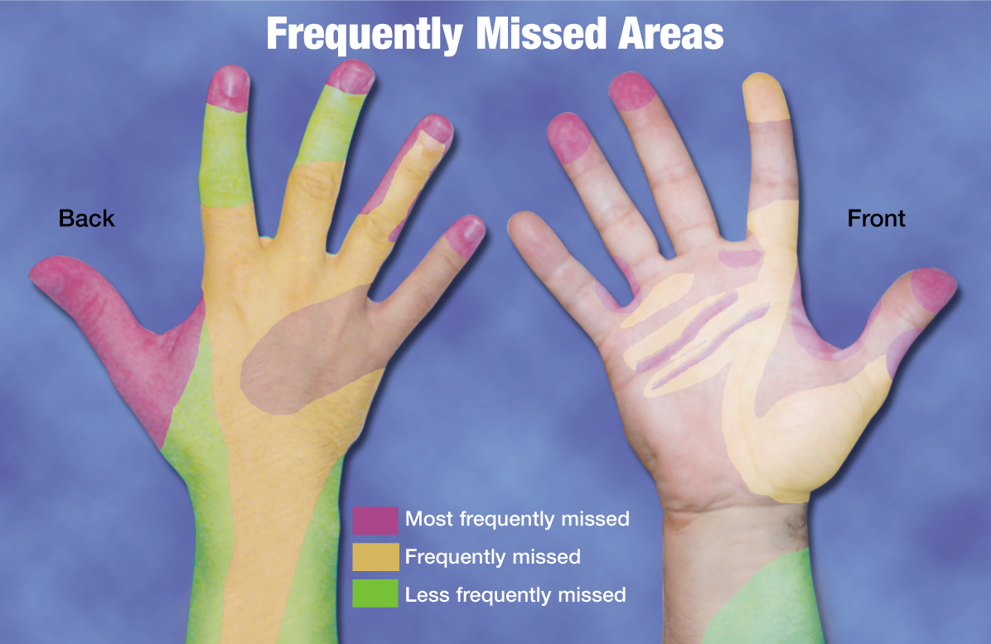
Hand hygiene Techniques

Slide 22
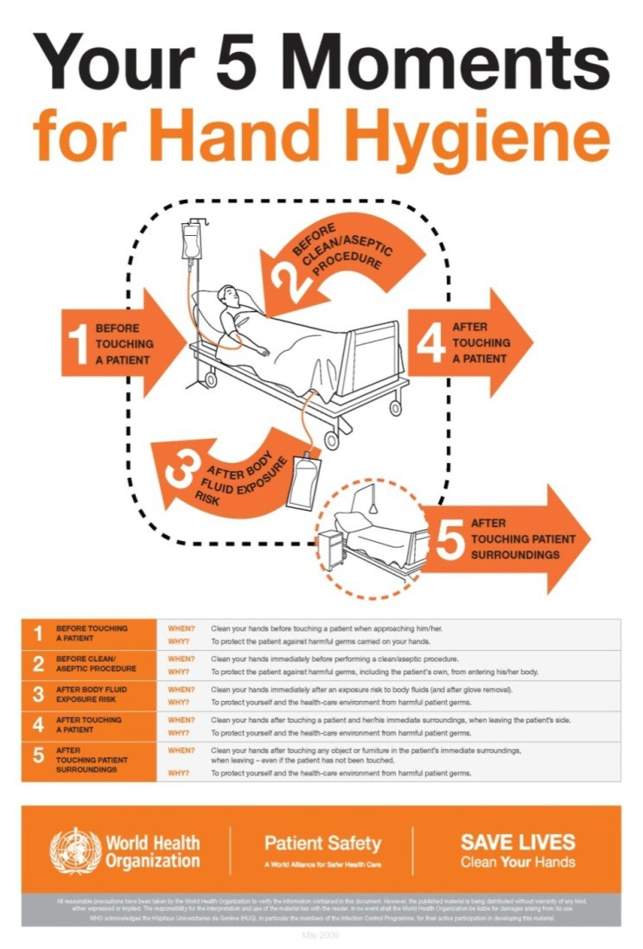
Hand Hygiene
My 5 Moments for Hand Hygiene
The My 5 Moments for Hand Hygiene approach defines the key moments when health-care workers should perform hand hygiene.
This evidence-based, field-tested, user-centered approach is designed to be easy to learn, logical and applicable in a wide range of settings.
WHO Save Lives: Clean Your Hands http://www.who.int/gpsc/5may/background/5moments/en
Notes:
WHO Save Lives; Clean Your Hands
http://www.who.int/gpsc/5may/background/5moments/en/
Hand hygiene indications identify the points in time when hand hygiene should be performed to interrupt pathogen transmission during care.

Slide 23
Hand Hygiene-cont.
This approach recommends health-care workers to clean their hands
  before touching a patient,
  before clean/aseptic procedures,
  after body fluid exposure/risk,
  after touching a patient, and
  after touching patient surroundings.
WHO Save Lives: Clean Your Hands http://www.who.int/gpsc/5may/background/5moments/en
Notes:
WHO Save Lives; Clean Your Hands
http://www.who.int/gpsc/5may/background/5moments/en/
The five moments include: before touching a resident, before clean or aseptic procedures, after body fluid exposure risk, after touching a resident, and after touching a resident’s surroundings.

Slide 24
5 Moments
Moment 1
  Before touching a resident (direct contact)
    Before Taking vitals
    Before Assisting with personal care
Moment 2
  Before performing clean or aseptic procedures
    Before preparing or administering an injection.
    Before inserting an indwelling urinary catheter.
  When moving from a contaminated site to a clean body site
    After removing and discarding a soiled brief
    and before assisting the resident to put on a clean gown.
Notes:
Hand hygiene is one element of aseptic technique that is used to prevent microbial contamination of medications or devices

Slide 25
5 Moments cont.
Moment 3
  After body fluid exposure (blood, body fluids, excretions, mucous membranes, non- intact skin or wound dressings)
  After glove removal
  After Personal Protective Equipment (PPE) is removed
  Examples:
    After toileting a resident
    Performing wound care
    Performing a finger stick for Blood glucose

Slide 26
5 Moments cont.
Moment 4
  After touching a resident even if PPE is worn
    After touching a resident in a group session in a physical therapy gym
    When leaving a resident’s room after a care activity
Moment 5
  After touching the resident’s surroundings
    After contact with inanimate objects (including medical equipment) in the immediate
      After changing bed linens the resident.
      After repositioning a bedside table.
      After adjusting a resident's IV fluid.
Notes:
This indication is particularly important when staff members are interacting with more than one resident in a shared environment, such as roommates or during group session in a physical therapy gym. Hand hygiene prevents a staff person’s hands from transferring pathogens from one resident to another. Performing hand hygiene after touching a resident also protects the staff person from acquiring a pathogen from direct contact and may decrease the spread of pathogens to surrounding environment. When concluding any care activity which involves direct contact with a resident, staff members should clean their hands as they exit the resident care area
The final hand hygiene moment is after contact with inanimate objects, including medical equipment, in the immediate vicinity of the resident.

Slide 27
Video on hand hygiene
https://www.bing.com/videos/search?q=The+Who+5+Hand+Hygiene&&view=detail&mid=6B962AD3D6C9D75E4DBF6B962AD3D6C9D75E4DBF&&FORM=VRDGAR

Slide 28

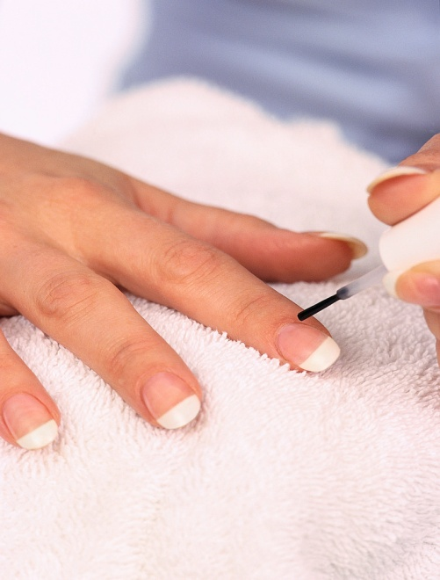
Hand Hygiene Policy
Washing
Moisturizing
Artificial Nails
  Artificial nail surfaces (e.g., extensions,
  overlays, acrylic, silk wraps,
  enhancements)
Jewelry
Intact Skin
Things your hands touch

Slide 29
Policy & Procedure on Hand Hygiene
Policy
Rationale /Purpose as to why hand hygiene is important
Responsibility – denotes who is responsible for following this P&P
Define the 2 methods for performing hand hygiene
  ABHR & Handwashing
Indications for performing hand hygiene
  Indications of when hand hygiene should be done
  Glove use
  Fingernail length
  Artificial nails & Nail extenders
  Use of lotions
Maintaining Hand hygiene supplies
Notes:
Because germs can escape the cleaning effects of ABHR and handwashing when sheltered under fingernails, CDC recommends that natural nail tips should be kept to one-quarter of an inch. Your facility’s hand hygiene policy should include guidance on fingernail length, and may also address circumstances when artificial nails should not be used by direct care staff. Your policy should also address the use of hand lotion by staff in the facility. Providing creams or lotions will help minimize skin irritation and decrease skin dryness that happens from cleaning your hands frequently. When selecting hand lotions, it is important to review information from the manufacturer to ensure that hand lotions are compatible with the hand hygiene products in use at the facility. Staff members should be educated about potential issues with compatibility and instructed to only use products provided by the facility while at work. Efforts should be made to periodically assess staff satisfaction with selected products. Ensuring access to acceptable hand lotions can support staff adherence to hand hygiene

Slide 30
P&P cont.
Procedure
  Outline the steps and supplies necessary to perform hand hygiene
    Using the steps indicated in previous slides
    Divide it into the 2 methods
    Include the length of time
  Other P & P’s should include the element of hand hygiene as well
    Such as Finger sticks etc.
  Resources

Slide 31
Education
All staff need to be educated about hand hygiene
This improves the compliance if they know the 5 W’s
  What, When, Why, Where & How
Training Resources in addition to the 5 Moments
  CDC Clean Hands Campaign offers posters, factsheets and brochures for facility staff and residents.
  ​The Medicare Learning Network (MLN) has web-based training that addresses hand hygiene and other infection control topics
Residents and families need to be educated as well through posters, meetings and role models.
Notes:
Resident education resources listed on the resource slide

Slide 32
When Staff should be Trained
Training should be provided:
  On hire
  Annually
  With new products
  With new Policies & procedures
  When indicated due to surveillance
Competencies should be completed following training
  Can be incorporated into other skill testing if needed
  Document the competency assessments

Slide 33
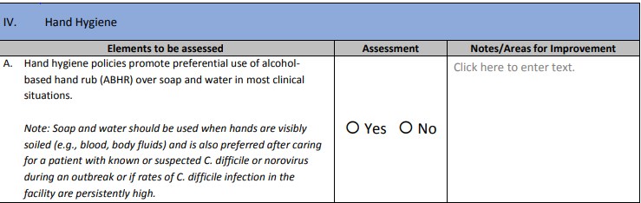
Infection Risk Assessment
https://www.cdc.gov/infectioncontrol/pdf/icar/ltcf.pdf
CDC Infection Prevention and Control Assessment Tool for Long-term Care Facilities.

Slide 34
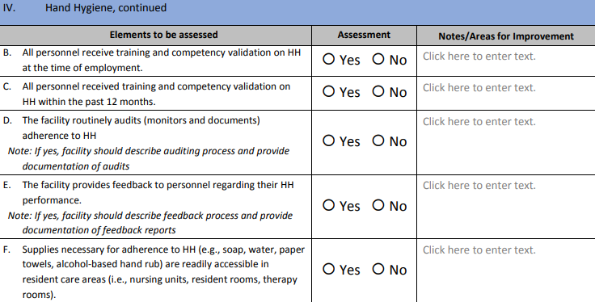
Infection Risk Assessment cont.

Slide 35
Performance Monitoring ( Surveillance)
Monitor the staff’s hand hygiene performance and compliance with the facility’s P&P
Develop a checklist or assessment to do this
This data is always reported in the positive such as 40 % compliant instead of 60% non- compliant
Once the data has been reviewed a determination of the action required is necessary and those steps need to be taken with the outcome documented as well.
This data should be presented to the:
  Infection Control Committee
  QA&A Committee
  Staff
  Physicians
Notes:
The three components of education are
the actual training
The competency testing
Performance monitoring

Slide 36
Product Selection Accessibility
Selection
When deciding on products obtain staff input
Items such as Smell, color, consistency and drying effect can affect staff compliance
Availability and accessibility
  Considerations for placement
    Place in resident care areas and other locations where it might be needed
      Nursing units, resident rooms, dining rooms, therapy rooms, medication rooms or med carts, lobbies or entrances to facility
    Areas where there are no sinks
    Gather staff input on this as well
  Be compliant with regulations
    Store these products away form ignition sources such as light switches, electrical outlets, flames
Notes:
Proper placement of hand hygiene products is critical to ensure that staff members consistently perform hand hygiene. When considering placement of ABHR dispensers, facilities should ensure that placement does not conflict with federal, state, or local regulations, including fire safety codes and requirements under the Americans with Disabilities Act. Staff members should be educated that alcohol-based products are flammable. Policies and procedures should include storing these products away from ignition sources, such as light switches, electrical outlets, and flames. The National Fire Protection Association website is an important resource for fire safety codes and standards.

Slide 37
Installation and Maintenance of ABHR Dispensers
Installation
  In a manner to minimize leaks and spills that could lead to falls
  Protect against inappropriate access by residents
  Maintain however resident accessibility
Identify who will maintain the dispensers and supply the pocket sized bottles
  Determine when this monitoring and replenishment will be done
  Determine at what point or degree of empty will the product be replaced
  Do not refill or top of dispensers
Notes:
Your hand hygiene policies and procedures should address how and when the product should be replaced, based on manufacturer’s instructions. Responsible staff members should know that existing product containers must not be refilled or topped off; empty product containers should be discarded and replaced with a new product container.

Slide 38
Role Models.
Colleagues, trainees, and other staff watch what you do:
Research has shown that the actions of clinicians influence the behavior of others.
Show your colleagues that hand hygiene is an important part of quality care.
Your patients watch you too:
Your actions send a powerful message.
Show your patients that you are serious about their health.

Slide 39
Formula for Success
HAI Prevention
Clean Hands
Clean &
Sanitary
Environment
Clean Skin

Slide 40
Quiz Question
Before eating what type of hand hygiene is CDC recommending?
  A. Soap & Water
  B. Alcohol Based Hand Gel
Please send answer to your instructor.

Slide 41
Resources
https://www.who.int/campaigns/world-hand-hygiene-day
The National Fire Protection Association website https://www.nfpa.org/
Resident Education resources
Association for Professionals in Infection Control and Epidemiology.
https://www.cdc.gov/patientsafety/features/clean-hands-count.html#:~:text=CDC's%20Clean%20Hands%20Count%20campaign,providers%20to%20clean%20their%20hands.QualisHealth Roadmap to Engaging Patients and Families.
WHO Advocacy Toolkit​​​​​​​. https://www.who.int/publications/m/item/annual-5-may-advocacy-toolkit

Slide 42


