Slide 1
Session 2- Infection Control Program Components
© 2022 National Association of Directors of Nursing Administration in Long Term Care, Inc. (NADONA LTC).
All rights reserved

Slide 2
Objectives
The participant will be able to:
1. Define the purpose of the infection prevention and control program
2. Identify the core elements of the IPC program
3. Identify what IPC policies and procedures should contain

Slide 3
Purpose of the Infection Prevention Control Program (IPCP)

Slide 4
Purpose of the IPCP
The purpose of an active IPCP is
“to provide a safe, sanitary, and comfortable environment and to help prevent the development and transmission of communicable diseases and infections.”

Slide 5
Purpose cont.
2 parts of the purpose:
Environment
Safe
Sanitary
Comfortable
Prevent communicable disease and infections
Development
Transmission

Slide 6
Infection Control Program Elements

Slide 7
IPCP Elements
Developing and implementing written policies and procedures
Implementing a system for infection surveillance (preventing, identifying, reporting, investigating, and controlling infections and communicable diseases
Creating a system for recording incidents and actions
Linen Handling
Conducting an annual review of IPC program
Establishing an Antibiotic Stewardship program
Infection Control Preventionist (11/19)

Slide 8
Policies and Procedures

Slide 9
Developing and Implementing Written P&Ps
A policy defines and provides rationale and evidence for a required practice (which includes guidance on how to implement the practice.)
A policy needs to state what the practice is and what it is based on
A policy needs a purpose that provides background that explains why the practice is needed
A procedure delineates the steps or actions needed for performing the practice
Key terms should be defined within the procedure

Slide 10
Developing and Implementing Written P&Ps cont.
The P&P identifies who is responsible for following this policy and procedure.
The steps should identify when the practice should be performed
It should also provide any other related additional information regarding the practice
It should include the supplies and equipment needed and supply monitoring
All resources used to create the document should be referenced
Notes:
Fingernail length/ fake nails, hand lotion etc.

Slide 11
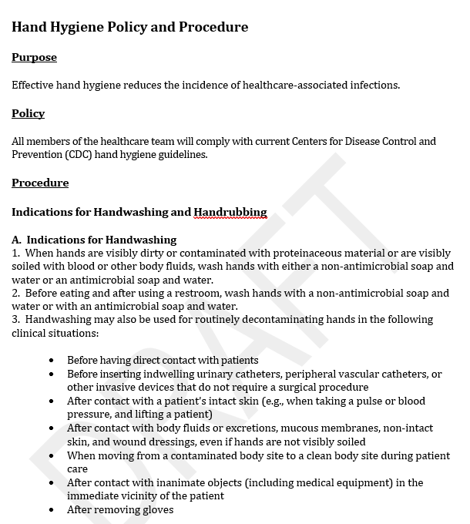
Your Topic Goes Here
Your Subtopics Go Here
Notes:
Corporate or commercial templates may be used. Here is an example.

Slide 12
Policy & Procedure Implementation
Effective Implementation
Review and get approval
Accessibility
Locate P&Ps where staff can find – paper/electronic
Education/training – competency assessment
Hire/ annual and when P&Ps are revised
Assessments to determine competency
Knowledge based testing and direct observation
Notes:
Get staff input before finalizing P&P (QAA) IDT etc.

Slide 13
Policy & Procedure Implementation cont.
Performance monitoring & feedback
Monitoring
Detects knowledge gaps
Provides opportunity for on the spot training
Recognize need for additional supplies
Training for those doing the monitoring
What is the correct procedure
How & when to observe these activities
Provide them with data collection tools mirroring the procedure

Slide 14
Policy & Procedure Implementation cont.
Feedback
To Leadership & staff
Highlights the importance of IPC activities
Keeps staff informed of P&P
Relayed in various manners
Summarized for the whole facility
By unit, shift or even by physician
Individual info shared on a 1:1 basis ( or at when infraction of P&P occurred.
Annual review of all policies and procedures

Slide 15
Infection Prevention and Control Program Policies and Procedures
(Standards and Guidelines often included in bibliography in IGs)
These IPCP policies and procedures must include, at a minimum:
IPCP policy that includes PLAN based on Risk Assessment
Surveillance Program
Standard precautions, Cough Etiquette and Transmission-based precautions to include PPE use, donning/doffing, resident placement,
Outbreak Management
CAUTI Guidelines (APIC 2014) and Appropriate DX for use
Hand hygiene (HH)
Specialty services policies: Mechanical Ventilation, Infusion Therapy, Dialysis etc.. Facility specific
Wound/skin care
Incontinence Care

Slide 16
Infection Prevention and Control Program P&Ps cont.
Performing fingersticks and point-of-care testing and disinfection of machines after use
Preparation, administration, and care for ALL medications administered (tablets, Injections, eye gtts etc..)
Environmental cleaning/disinfection: Routine cleaning and disinfection daily in all areas of building and discharge cleaning.
Cleaning/disinfection of personal and shared resident care equipment
Written occupational health policies that address reporting of staff illnesses and following work restrictions
Assessing risks for tuberculosis (TB) and Screening Staff and Residents per Guidelines
Implementing an exposure control plan in order to address potential hazards posed by blood and body fluids, and injection safety
Education and competency assessment to ensure staff follow the IPCP’s standards & policies

Slide 18
Infection Surveillance

Slide 19
Surveillance
Purpose :
Identify infections
Monitor that the IPC practices are being followed
Prevent the spread of infections/pathogens within the facility
Outcomes of the IPC program data help to:
Identify trends (infections/pathogens)
Detect outbreaks
Determine level of compliance with P&Ps
Recognize opportunities to improve IPC practice performance
Track progress towards identified priorities on the risk assessment and use in developing new priorities
Notes:
Injection safety
Glucose testing
Hand hygiene
Outbreak: occurrence of more cases of a communicable disease or pathogen than is expected in a facility over a specified period of time.

Slide 20
Types of Measures
Process (Performance) Measures:
Identify specific practices for monitoring staff compliance
Performed through
Practice audits
Direct observation
Review of documentation
Outcome Measures
Specific infection events (infection/pathogens)
MDROs
Helps identify outbreaks
Notes:
Process: Hand hygiene / use of PPE/ safe injection practices/blood testing/documentation of duration and indications of new antibiotic prescriptions
Outcome:
Pneumonia/ wound infections/UTI GI Pathogens: CDIff/ MDROs/MRSA/CRE

Slide 21
2 Types of Outcome Measures
Outcome Measure Surveillance has 2 types:
Comprehensive or Facility – Wide
Tracks every infection in entire facility population
Benefit:
Aware of all infections occurring in the facility
Risk
Time consuming
Takes up many resources
Reduces time to analyze data
Targeted
Focus is on high risk or high consequence
Benefit
More time for detailed data collection
Risk –
Still must do some facility wide surveillance to detect outbreaks and new pathogens.

Slide 22
Surveillance Plan
Develop a surveillance plan based on your facility risk assessment
Pinpoints focuses
Allows for consistency in surveillance endeavors
Outlines frequency
States definitions
Identifies forms to use
Defines calculations of data
Clarifies what to report and to whom.
Describes how to use the data

Slide 23
Steps to Surveillance
1. Facility Risk Assessment
2. Identify what Infection criteria will be used (ex: McGeer’s)
3. Determine forms to be used
4. Develop Surveillance plan using the above information
5. Train staff responsible for collecting data
6. Implement the data collection
7. Analyze the data
8. Report the findings and actions taken

Slide 24
Process Surveillance
Using the facilities P&Ps
Choose the IPC practices that could pose the greatest risk to the residents and staff if not followed:
Use of PPE
Look at:
appropriate PPE for the type of transmission isolation
Appropriate donning and removal of PPE
Disposal of PPE
Handwashing at appropriate times
Identify if barriers to compliance
Use data to provide 1-1 education at time of observance and additional training to other staff
Considered practice improvement

Slide 25
Outcome Surveillance
Facility Wide:
Examples:
Resident has a fever
New antibiotic start
Redden skin (wound)
Investigate every opportunity for infection
Fill out the forms and track the proposed infection
Targeted
New diarrhea
Vomiting
URI
Abnormal Lab values

Slide 26
Targeted Surveillance cont.
Investigate :
Resident Observations
Medical Record
Lab reports
EMAR /ETAR
Transfer documents
Analyze
Determine if infection based on criteria
Action
Determine what action needs to be taken and document

Slide 27
Calculating Surveillance Rates
Rates are indicative of the number of infection events occurring among the residents at risk
Example:
Twin Falls Facility has 3 UTIs among 150 residents in 30 days Greater Falls Facility has 6 UTIs among 550 residents in 30 days
Twin Falls 3 (infections) x 1000 = .66
4500 (days)
Greater Falls 6 infections x 1000 = .36
16,500 days
Notes:
Knowing the simple count of infections alone is not sufficient to understand the true burden of the problem because a count does not consider differences in the number of residents in the facility at risk during a specified period of time.

Slide 28
Calculating Infection Rates cont.
Twin Falls facility has the greater infection rate due to the fewer residents days at risk.
Sometimes when calculating an infection rate the denominator is a subset instead of the whole population. For example CAUTIs are infections where only catheterized residents are at risk. There for only those days would be calculated.

Slide 29
Formulas
Infection Rate Calculation =
# of infection events X constant ( 1000) = infection rate
# of resident days at risk
Performance Rate Calculation
Tracks staff compliance to IPC P&Ps
# of times the practice was compliant x 100 = percent compliant
# of opportunities monitored
32 of times correct catheter care provided X 100 = 36.8% compliant
87 opportunities for catheter care
Notes:
Generally, infection surveillance is summarized either monthly or quarterly, depending on how frequently an event occurs in the facility.
To make the rate easier to handle we either multiply by 1000 or 10,000 . 3/8939 days would equ7al .00033 so by multiplying by 10,000 it would then reflect that 3.3 infections in 10,000 days

Slide 30
Stratification
Stratification is classifying into categories to assist with interpretation
Outcome Surveillance
Type of Infection
Type of Pathogen
Performance
Unit
Staff Positions
Helps determine where prevention approaches might be needed the most

Slide 31
Recording Incidents and Actions

Slide 32
Reporting Data/Trends
Reports
Done over time
Estimates the occurrence of infections
Average rates for 6 or 12 months
Can be used for comparing data and outcome of actions implemented
Can identify need for additional investigations
Presentation of Data
Displayed in graphs / charts / line charts
At staff meetings / QAPI/ Board Meetings/ IPCP meetings
Posted in prominent places where targeted audience would see them.

Slide 33
SOM - Appendix PP
Appendix PP states:
A facility must develop and implement a system for recording incidents identified under the facility’s IPCP and the corrective actions taken by the facility based on the investigation of the incidents.
A facility-identified incident (e.g., HAI) may include the spread of disease due to errors in infection prevention and control.

Slide 34
Recording and Reporting cont.
The facility’s system should include defining, identifying, analyzing, and reporting incidents related to failures in infection control practices to the director of nursing, medical director, and the QAA committee. These may include but are not limited to the following:
Identification of methods by which the facility would obtain information on incidents from residents, family, and direct care/direct access staff;
A description of how the facility addresses and investigates the incident(s);

Slide 35
Recording and Reporting cont.
Measures to be implemented for the prevention of incidents or potential incidents as they relate to infection prevention and control;
Development and implementation of corrective actions;
Monitoring for the effectiveness of its implemented changes; and
Methods for feedback to appropriate individuals involved in the failed practices.

Slide 36
Reporting and Recording cont.
Determine if isolated or a potential outbreak
Identify what types of infections need to be reported to the DON / Administrator / Public Agencies (Community/ State/ Federal)
Investigate why the infection occurred – Break in infection protocol?

Slide 37
Infection Prevention Line Listing
Items to include in a line listing:
RM & MR#
Name
Location /BDG/ Unit
ADM date or Readm
Length of Hosp.
Hosp. DC date
Type of Infection
Location of infection
If UTI is Catheter present
Signs & Symptoms (S&S) & Onset date
Lab & X-ray date & agency
Lab & X-ray results - sensitive to current antibiotic
Med TX Orders Date started / Dose / Freg? Route /
Indication for Antibiotic usage
Type of Antibiotic (Class)
Prescriber & Indication for order
Order from onsite visit / ER/ Clinic (indicate site name) Antimicrobial stop dates
Risk Factors Adverse Events / outcomes noted Infection
Items that could be included

Slide 38
Infection Prevention Line Listing
Classification HAI or CAI
If HAI did it meet the definition of infection
Resolution Date
Precautions: Type & Date
Antimicrobial Stewardship Program Interventions - Antibiotic Time Out etc.

Slide 39
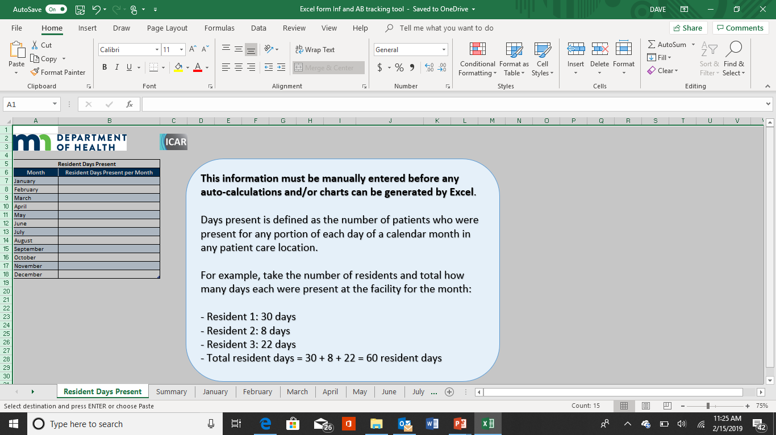
BRAND NEW EXCEL Infection and Antibiotic Tracking Tool
https://www.health.state.mn.us/diseases/antibioticresistance/hcp/asp/ltc/
index.html
Notes:
Here is an example that I personally think is the BEST one out there.
ON this page you write the resident days for each month

Slide 40
Screen shot of Inf. and Antibiotic Tracking Tool
Resident Information |  |  |  | Classification |  |  |  | History |  |  |  |  |  |  | Diagnostics (microbiology, other labs, radiology)
Unit Name | Resident Name | Room # | Admit Date | Existing Infection from Previous Month(s)? Y/N | Infection type | Body System of Infection | Surveillance definition met? Y/N | Symptom(s) | Onset Date | Device Type(s) | Date(s) of Insertion | Date(s) of Removal | Device Days | Infection Risk Factors | Diagnostic Performed? Y/N | Test Date | Type of Test | Specimen Source | Results (Organism colony counts for urine)
Notes:
This is the sheet on the workbook where you record the data for each suspected or known infection

Slide 41
https://www.health.state.mn.us/diseases/antibiotic resistance/hcp/asp/ltc/apxlinstructions.pdf
Notes:
There is a guide that shows you exactly what to do included with the excel sheet

Slide 42
Data tables and graphics automatically populated for user
Notes:
In this ONE STOP SHOP form… you also get all your rates computed for you as well and it creates tables and graphics for you to present at your QAPI IPCP and AS portion of your meeting

Slide 43
Example of Infection Line Listing

Slide 44
Example of MDRO Line Listing
Notes:
Could also keep separate logs on CA UTIs
Influenza etc.

Slide 45
Antibiotic Stewardship

Slide 46
Core Elements
Core elements for antibiotic stewardship in nursing homes include:
Facility leadership commitment to safe and appropriate antibiotic use;
Appropriate facility staff accountable for promoting and overseeing antibiotic stewardship;
Accessing pharmacists and others with experience or training in antibiotic stewardship;

Slide 47
Core Elements cont.
Implement policy(ices) or practice to improve antibiotic use;
Track measures of antibiotic use in the facility (i.e., one process and one outcome measure);
Regular reporting on antibiotic use and resistance to relevant staff such as prescribing clinicians and nursing staff; and
Educate staff and residents about antibiotic stewardship.
This elements were discussed in Week 1 but bear repeating
As they are an important element of the IPCP.
In Week 14 we will be spending an entire hour on this topic and the complexities of implementing it.

Slide 48
Annual Review of IPC Program

Slide 49
IPC Risk Assessment
Definition:
Evaluates the residents and services provided to recognize possible infection risks or exposures
Purpose:
Determine the IPC priorities and goals
Review and update P&Ps
Needed resources to prevent transmission of pathogens and development of infections
Items to consider:
Community infections
Resident population risks
Services provided (Catheters/ wound care/ IVs)
Staff performance of infection P&Ps

Slide 54
Linen
Personnel must handle, store, process, and transport linens so as to prevent the spread of infection . Part of F Tag 880
More on this in Session 12

Slide 55
Resources
https://www.federalregister.gov/documents/2015/08/04/2015-18950/medicare-program-prospective-payment-system-and-consolidated-billing-for-skilled-nursing-facilities
CDC Core Elements - https://www.cdc.gov/antibiotic-use/core-elements/nursing-homes.html

