Slide 1
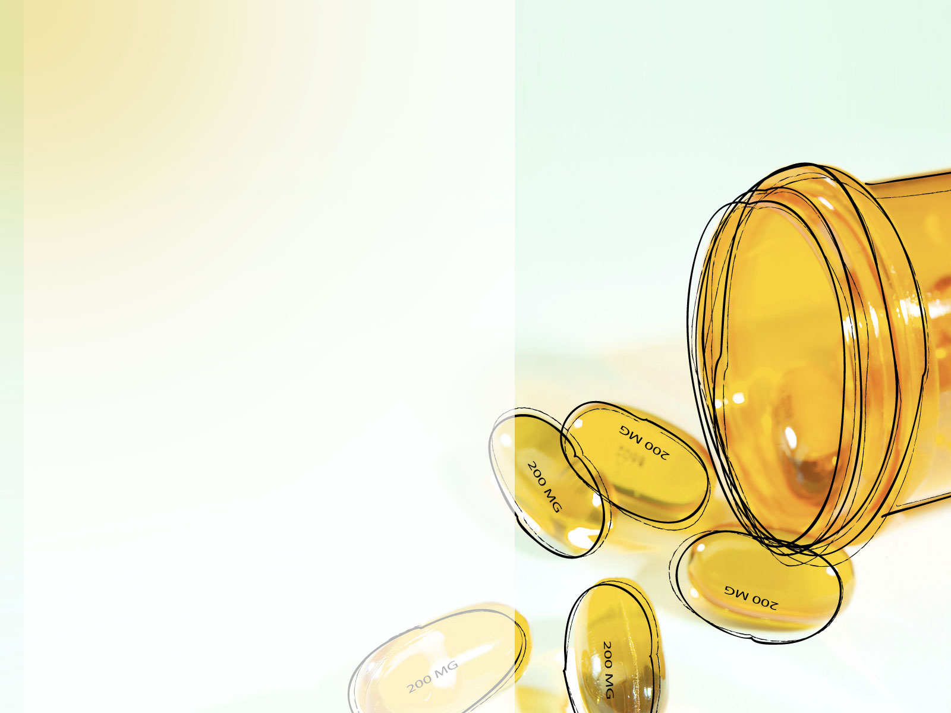
Session 12 - Safe Injection Practices;
Respiratory Hygiene & Cough Etiquette
Linen Handling;
© 2022 National Association of Directors of Nursing Administration in Long Term Care, Inc. (NADONA LTC).
All rights reserved.

Slide 2
Standard Precautions
Consists of:
  Hand Hygiene
  Safe Handling of Patient Care Equipment
    Cleaning, disinfection, sterilization
  Proper Use of Personal Protective Equipment
    Gowns
    Mask
    Eye Protection
    Gloves
  Safe Injection Practices
  Respiratory Hygiene / Cough Etiquette
  Point of Care Testing
Centers for Disease Control and Prevention. (2007). Guidelines for isolation precautions: Preventing transmission of infectious agents in healthcare settings 2007. Retrieved January 5, 2010 from http://www.cdc.gov/ncidod/dhqp/pdf/guidelines/Isolation2007.pdf

Slide 3
Safe Injection Practices

Slide 4
Objectives
Identify 3 items used in giving injections or drawing blood that might pose a risk for a potential exposure
Describe 3 safe injection practices
List 4 injection safety recommendations
Explain what post-exposure prophylaxis is

Slide 5
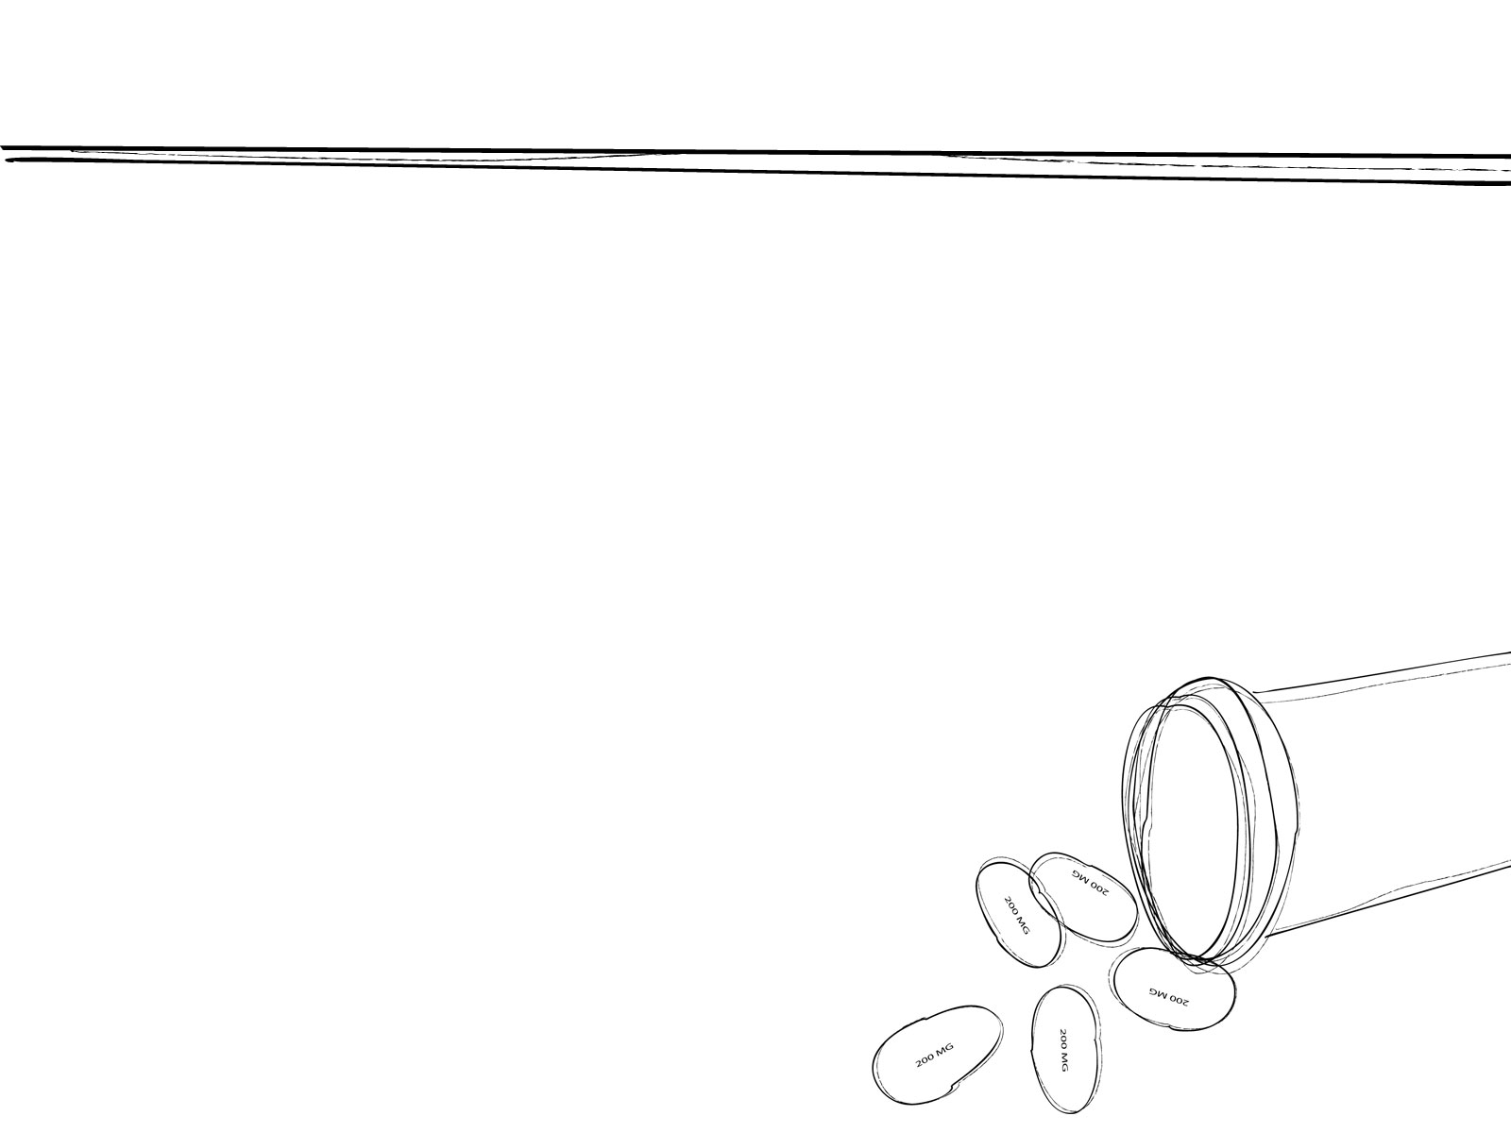
Safe Injection Practices

Slide 6

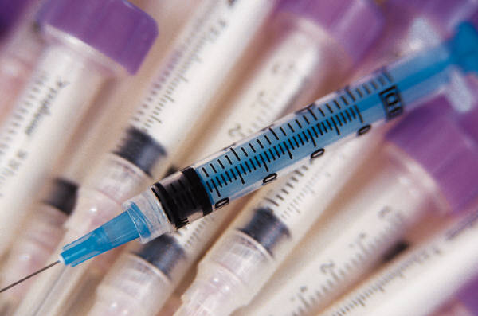
Safe Injection Practices
Aseptic technique for the preparation and administration of parenteral medications
  Use a sterile, single-use, disposable needle and syringe for each injection
  Prevention of contamination of injection equipment, medication and patient care equipment
  Whenever possible, use single-dose vials over multiple-dose vials, especially when medications will be administered to multiple residents.
OSHA Regulates and protects healthcare workers from occupational exposure
Notes:
The investigation of four large outbreaks of HBV and HCV among patients in ambulatory care facilities in the United States identified a need to define and reinforce safe injection practices ⁴⁵³. The four outbreaks occurred in a private medical practice, a pain clinic, an endoscopy clinic, and a hematology/oncology clinic. The primary breaches in infection control practice that contributed to these outbreaks were
1) reinsertion of used needles into a multiple-dose vial or solution container (e.g., saline bag) and 2) use of a single needle/syringe to administer intravenous medication to multiple patients.

Slide 7
Key Injection Safety Recommendations
Use aseptic technique when preparing and administering medications
• Cleanse the access diaphragms of medication vials with 70% alcohol before inserting a device into the vial
• Never administer medications from the same syringe to multiple patients, even if the needle is changed or the injection is administered through an intervening length of intravenous tubing
• Do not reuse a syringe to enter a medication vial or solution
• Do not administer medications from single‐dose or single‐use vials, ampoules, or bags or bottles of intravenous solution to more than one patient

Slide 8
Key Injection Safety Recommendations cont.
• Do not use fluid infusion or administration sets (e.g., intravenous tubing) for more than one patient
• Dedicate multidose vials to a single patient whenever possible. If multidose vials will be used for more than one patient, they should be restricted to a centralized medication area and should not enter the immediate patient treatment area (e.g., operating room, patient room/cubicle)
• Dispose of used syringes and needles at the point of use in a sharps container that is closable, puncture‐resistant, and leak‐proof.
• Adhere to federal and state requirements for protection of HCP from exposure to bloodborne pathogens.

Slide 9
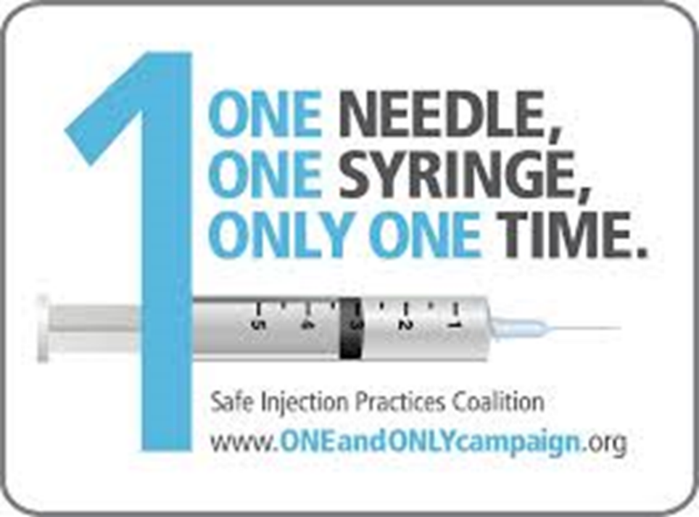
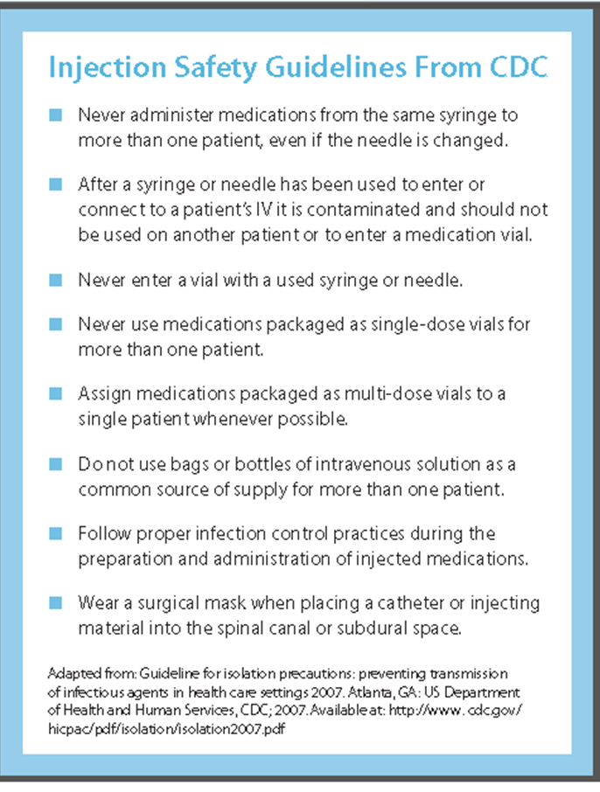
SAFE HANDLING OF MEDICATION
http://www.oneandonlycampaign.org/single-dose-multi-dose-vial-infographic

Slide 10
Respiratory Hygiene / Cough Etiquette

Slide 11
Objective
List 3 components of Respiratory Hygiene & Cough Etiquette

Slide 12
Respiratory Hygiene / Cough Etiquette
Components:
Education of staff, residents and visitors
Posted Signs (language appropriate to population served) with instructions
Source control measures (cover cough, prompt disposal of tissues, surgical mask)
Hand Hygiene after contact with respiratory secretions
Spatial Separation (> 3 feet)

Slide 13
Key Recommendations for Cough Etiquette and Respiratory Hygiene
Implement measures to contain respiratory secretions in patients and accompanying individuals who have signs and symptoms of a respiratory infection, beginning at point of entry to the facility and continuing throughout the duration of the visit.

Slide 14
Key Recommendations for Cough Etiquette and Respiratory Hygiene-cont.
•Post signs at entrances with instructions to patients with symptoms of respiratory infection to:
  •Cover their mouths/noses when coughing or sneezing
  •Use and dispose of tissues
  •Perform hand hygiene after hands have been in contact with respiratory secretions
  •Provide tissues and no‐touch receptacles for disposal of tissues

Slide 15
Key Recommendations for Cough Etiquette and Respiratory Hygiene cont.
  Provide resources for performing hand hygiene in or near waiting areas
  Offer masks to coughing patients and other symptomatic persons upon entry to the facility
  Provide space and encourage persons with symptoms of respiratory infections to sit as far away from others as possible. If available, facilities may wish to place these patients in a separate area while waiting for care

Slide 16
Key Recommendations for Cough Etiquette and Respiratory Hygiene cont.
Educate HCP on the importance of infection prevention measures to contain respiratory secretions to prevent the spread of respiratory pathogens when examining and caring for patients with signs and symptoms of a respiratory infection.

Slide 17
Linen Handling

Slide 18
Objectives
Explain how linens may transmit pathogens.
Describe recommended practices for linen management.

Slide 19

Break the Chain of Infection
Notes:
Proper linen management is important to break the chain of infection. Although most linen is not required to be sterile, it does need to be “hygienically clean,” which the Association for the Advancement of Medical Instrumentation defines as “free of pathogens in sufficient numbers to cause human illness.”

Slide 20
How are Linens Involved in Pathogen Transmission?
Resident linen:
  Bed coverings,
  Towels,
  Washcloths
Can become contaminated with potential pathogens through contact with:
  Intact skin or Body substances
  Blood
  Stool
  Vomitus
  Other body fluids
Pathogen transmission occurs through direct contact with the contaminated linens or aerosols generated through sorting or handling of linens
CDC. Guidelines for environmental infection control in health-care facilities.
https://www.cdc.gov/infectioncontrol/guidelines/environmental/background/laundry.html

Slide 21
Components of Handling of Linen
Collection
Transport
Laundry Area
Sorting
Transport
Storage
Notes:
Over the next several slides, we will discuss the recommended practices for linen management, including the collection and transport of used linen; the sorting and laundering of used linen; and the transport and storage of clean linen. Even if laundry services are provided by an offsite entity, such as a commercial laundry,
facilities should still have policies and procedures in place to address proper collection and transport of used linen and proper transport and storage of clean linen returned to the facility. They should also verify that the offsite facility has policies and procedures to launder and transport linen in a way that maintains a hygienically clean state.

Slide 22
Collection
Laundry Process
  Starts with the removal of used linen from the point of use
  Handle linen using Standard precautions
    Hand hygiene
    PPE
  Minimize the handling of used linen
    Do not shake or hold used linen close to the body (avoid touching clothing/PPE)
    Do not sort or rinse linen at the point of use

Slide 23
Transport
Used linen should be placed into designates bags or other appropriate containers at the point of use
  Use single bags of sufficient strength
  Bags should be leak proof if laundry is wet or capable of soaking through a cloth bag
  Securely tie or close bags or collection containers to prevent leakage during transport
  Do not drag bags on floor / use cart or carry the bags away from clothing

Slide 24
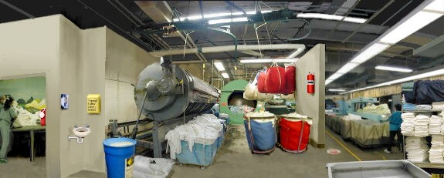
Laundry Area

Slide 25
Laundry Area
Laundry done onsite
  Should have 2 separate areas
    A dirty area for receiving and handling of used linen
    A clean area for processing washed items
    To minimize the potential for recontamination the dirty area should be at a negative air pressure compared to the clean area
    Hand hygiene supplies and appropriate PPE should be available
    Laundry equipment should be used and maintained according to manufacturers recommendations.
CDC. Guidelines for Environmental Infection Control in Health-Care Facilities.
https://www.cdc.gov/infectioncontrol/guidelines/environmental/background/laundry.html

Slide 26
Sorting
Part of the laundry process
  Done to remove any hard objects such as sharps or other resident property ( glasses, dentures)
  Sorting should be done before washing if possible
  Facility policy should indicate when sorting is to be done ( not at point of care)
  Gloves such as utility gloves of appropriate thickness should be used to minimize sharps injuries

Slide 27
Transport of Clean Linen
Package clean to prevent contamination during transport or storage
  Use a hamper lined with an unused liner which is closed or covered
  A clean cart can be used when it is covered with either a disposable material or a cleaned reusable textile material that can be attached to the cart
  Clean linen can be wrapped in plastic in individual bundles or another suitable material then seal or tape the bundles
  Separate carts should be used to transport clean and used linen
    If same cart then it must be cleaned and disinfected prior to using for clean linen

Slide 28
Storage
Clean linen needs to be stored in dedicated clean areas that will maintain the linen dry and free from soil or contamination
Areas both central and on unit should be
  Constructed to minimize dust contamination
  Maintained at normal room temperature and humidity levels
Separate rooms, closets or other areas with a closing door is the best method of reducing the risk of environmental contamination
Notes:
Having on unit areas is a best practice to eliminate the need for staff to carry linen to far to point of use.

Slide 29

How Does Your Laundry Rate?

Slide 30

Checklists

Slide 31
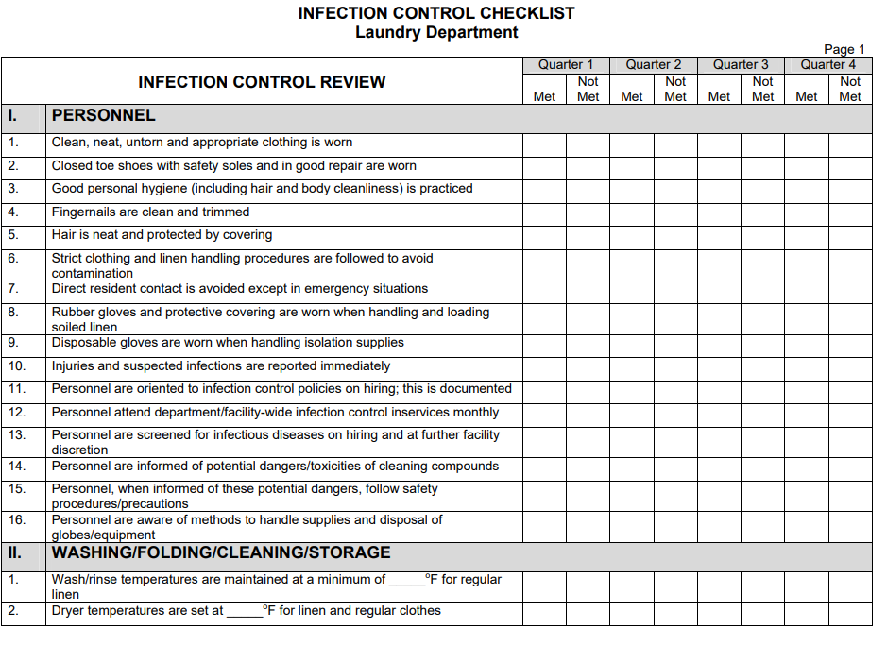

Slide 32
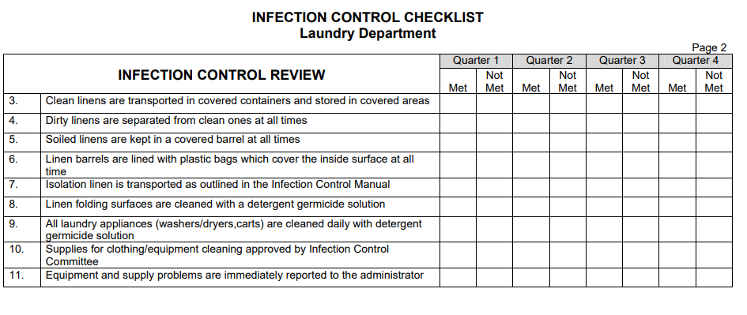

Slide 33
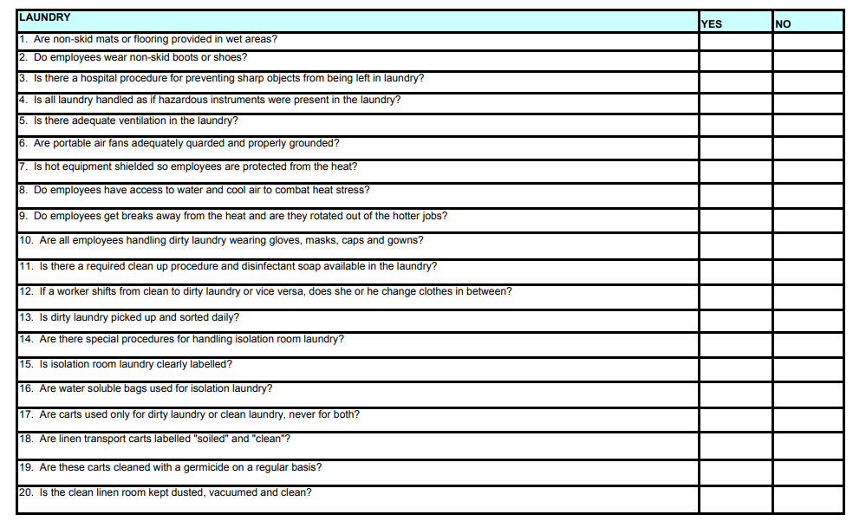

Slide 34
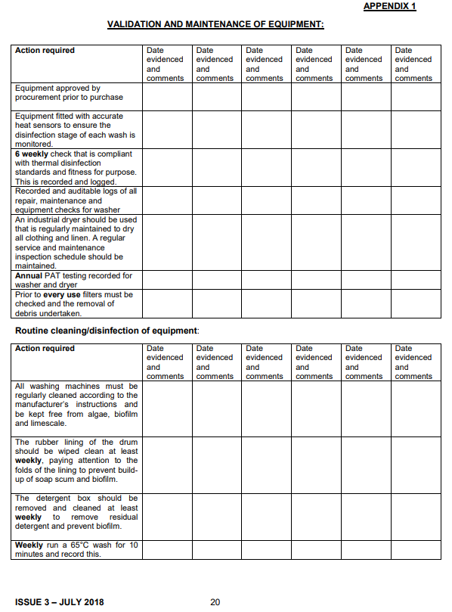

Slide 35
Infection Control Program
Include your linen program in your Infection Control Program
  Policies & procedures
    Handling of used linen
      Collection & transport of used linen
      Laundry Area
      Sorting & Laundering
      Transporting and storage of clean linen
    Tracking/Audit tools
    If using an off site laundry must still have all policies and procedures in place to prevent contamination and before and after laundering

Slide 36
Infection Control Program
Provide staff education & competency testing
  Laundry & Nursing staff (also anyone else involved in the linen process)
Accessibility of space & supplies
Performance monitoring & feedback

Slide 37
QUIZ Question
A nurse has encountered a needle stick. If she were treated following this event without proof of an infection it would be called:
A. Preventative Treatment
B. Post- Exposure Prophylaxis
C. Post Responsive Administration
None of the above
Please send answer to your instructor with your homework.

Slide 38
Resources
https://www.cdc.gov/infectioncontrol/pdf/guidelines/environmental-guidelines-P.pdf
https://www.cdc.gov/infectioncontrol/guidelines/environmental/background/laundry.html
https://www.cdc.gov/injectionsafety/one-and-only.html

Slide 39


